Slide 1
Notes:
- See the notes for each slide with more information
- Download these slides or watch the video at https://electionassembly.lgfl.net

Slide 2
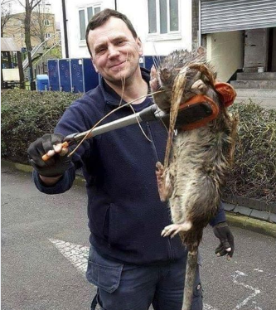
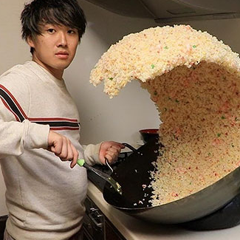
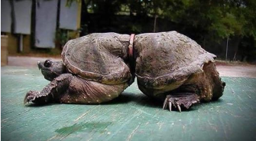
Activity 1
‘This man found this 12kg rat in London!!!’
‘Check out this awesome rice wave!’
‘This turtle grew like this when it got wrapped in ocean plastic!’
Only one of these images shows what it claims to. Which one?
Notes:
ANSWER – the turtle images is the only one - see next slide for more details.
Show these links once students have decided:
Rice - https://time.com/5513048/rice-photo-prank/
Turtle - https://fullfact.org/online/turtle-pastic/
Rat - http://www.bbc.co.uk/newsbeat/article/35788179/why-this-giant-rat-photo-may-not-be-quite-what-it-seems

Slide 3
General Election Live: Teacher’s sheet
Full Fact toolkit - https://fullfact.org/toolkit/
Answer to Activity 1
Answer: the image that shows what it claims is the turtle. The picture is a real photo of Mae West, a snapping turtle in California whose body adapted and grew around a plastic milk ring.
https://fullfact.org/online/turtle-pastic/
The 'fried rice meme' that appears to show a man making an incredible rice wave in his pan is fake. The rice wave is actually a sculpture that is sold in a fake food shop in Tokyo.
https://time.com/5513048/rice-photo-prank/
The rat image is from a Facebook page which specialises in optical illusions. It is a real rat, but it has been held closely to the camera to make it look bigger—and it almost certainly weighs less than 3kg.
https://fullfact.org/online/not-so-big-rat/
http://www.bbc.co.uk/newsbeat/article/35788179/why-this-giant-rat-photo-may-not-be-quite-what-it-seems
Handy tip: a Google reverse search (right click + ‘Google search for image’) will usually trace the spread of the image and help find the source.
This slide is hidden so will not show when you run the powerpoint

Slide 4
Activity 2
Discussion –
Have you ever seen or shared something online you think might have been wrong, or misleading?
What do you think might be the consequences of sharing something that isn’t true?
TIP: Think about the different kinds of bad information online. It might relate to a politician, a celebrity or even a health condition?
electionassembly.lgfl.net
Notes:
Teacher note:
This kind of discussion can be expanded for a future lesson by using the ‘Trust Me’ critical thinking resource from LGfL/Childnet – see fakenews.lgfl.net

Slide 5
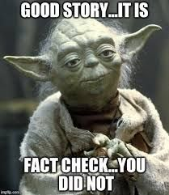
Activity 3
In pairs or small groups, design a meme that warns your friends about the dangers of fake news, and what they should do before they share something online.
TIP: think about the three questions from the assembly:
Where’s it from?
What’s missing?
How do you feel?
electionassembly.lgfl.net

Slide 6
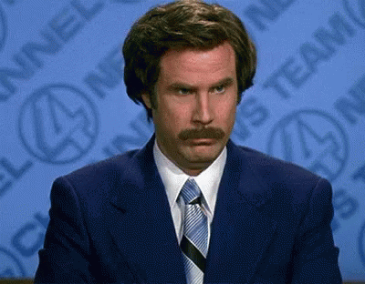
Activity 4
In pairs or small groups, find a story from each political party that other politicians have said is inaccurate.
Next swap stories with another group and look for evidence from independent sources to prove or refute the story.
Think about:
Does your decision depend on your opinion of other issues relating to the election?
If so, what are they / why do they influence your answer?
If the story is correct why might someone have said it is wrong?
electionassembly.lgfl.net
Notes:
Teacher notes:
Use reputable news sites plus fullfact.org (there are other fact checkers listed at fakenews.lgfl.net)
Consider if pupils’ idea of what political approaches are fair in their view impact on their decisions. This may make a good further discussion

Slide 7
General Election Live: Teacher’s sheet
Further resources:
Visit fakenews.lgfl.net for a range of resources to help you plan further lessons to support media literacy, including links to Full Fact and other fact checking sites, the Trust Me critical thinking resource and a variety of fake news lessons and ideas from other selected providers including the BBC, Guardian and more.
Remember to download these slides again or to watch General Election Live again or if you missed it, visit electionassembly.lgfl.net
This slide is hidden so will not show when you run the powerpoint

