Slide 1
Staff Inset / CPD materials from
LGfL DigiSafe on
LIVESTREAMING & VIDEO CHAT
Based on the Hopes & Streams report into the 2018 pupil online safety survey of 40,000 pupils across the UK: pupilsurvey.lgfl.net
* These slides cover issues which should be presented within a safeguarding training context, by / in consultation with your designated safeguarding lead

Slide 2
Feel free to edit this PowerPoint to meet the needs of your school staff but please do not try to edit the graphics or remove the brand logos or weblinks.
We would love to hear how you use this / if it’s useful, how we can improve it and what else we can do to support you – get in touch with @LGfLDigiSafe on Facebook or Twitter
NB: There are notes on each slide – including this one – to help the presenter.
Hopes & Streams report: pupilsurvey.lgfl.net
Livestreaming resources & signposting: livestreaming.lgfl.net
Notes:
BEFORE running a session for staff with these slides:
Speak to your DSL
Be sure to first read at least the Video Chat & Livestreaming’ section of the Hopes & Streams report at https://pupilsurvey.lgfl.net
DO NOT ask pupils about getting undressed on camera to replicate statistics here (or similar questions to elicit disclosures) without talking first to your DSL and ensuring the right frameworks are in place to support potential disclosures.
Stress the same point to staff.
However, you may wish to find out how many of your pupils have livestreamed (note they might have done it without knowing it is called that so discuss what it means if you ask them)
If your school took part in the survey, however, you will have been sent returns for your school which you may wish to share with staff.
Make sure you know what livestreaming is (this might help: https://www.thinkuknow.co.uk/parents/articles/what-is-live-streaming/)

Slide 3
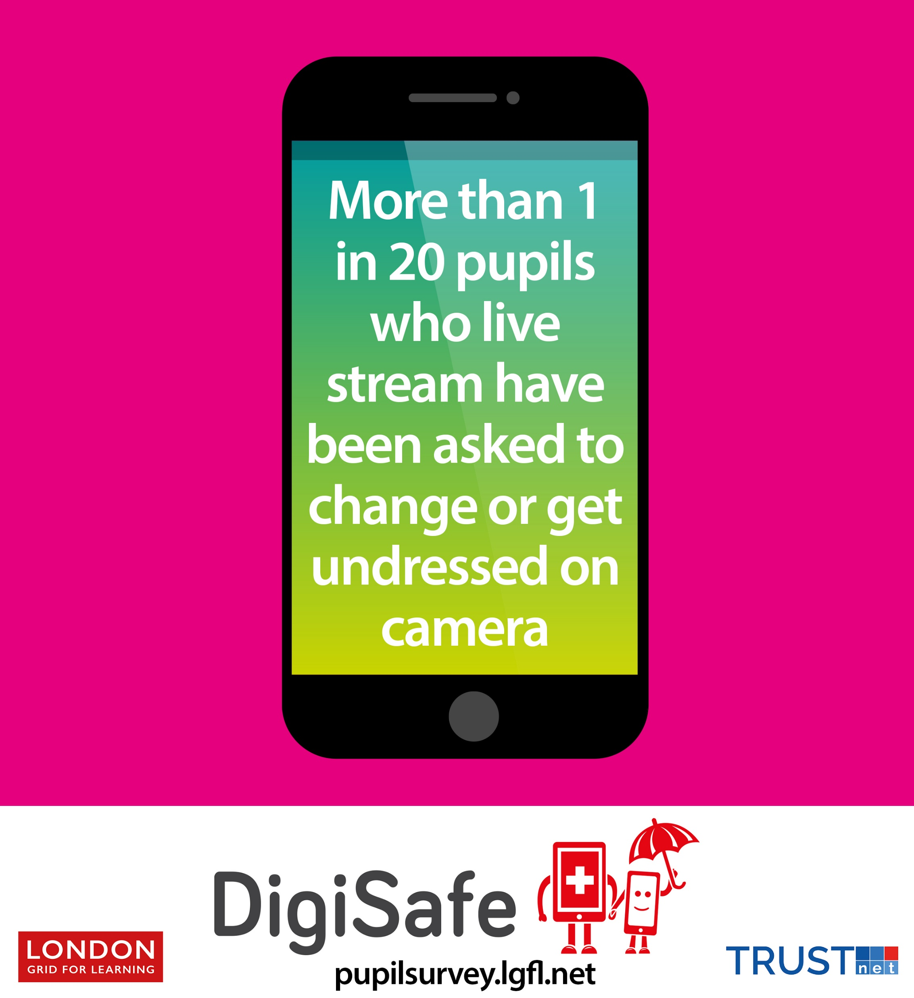
NB: This PPT includes animations; you need to play it to see it in action – e.g. questions appear one by one and the blanked out figures appear as you click through. This message will not appear when you run the presentation.
What is livestreaming?
What led us to ask this question (including the youngest pupils)?
With a partner, guess the missing number. Why did you pick that number?
Make sure you have the notes section visible as answers and suggestions are there for the person leading the inset.
Notes:
Q1 – If you need a definition, this might help: https://www.thinkuknow.co.uk/parents/articles/what-is-live-streaming/)
Q2 – See the report page 22 onwards: “warnings about sexual predators using livestreaming channels to sexually abuse and exploit children, particularly by tricking, enticing or coercing them to get undressed on camera.” This is particularly relevant for the youngest children or those with SEND who may not understand they are being tricked; with older students it will be different forms of coercion
Q3/4 – x

Slide 4
What surprises you about the real figure?
Could it happen with our pupils?
What would you do or say if you discovered that this had happened to a child in your class?
Notes:
Q4 – x
Q5 – This is a bit of a trick question, but alarm bells should ring if you hear ‘no’. Keeping Children Safe in Education page 7 “Staff members working with children are advised to maintain an attitude of ‘it could happen here’”
Please point out that this survey was run across the UK with 40,000 pupils, in primaries and secondaries aged 7-16
Q6 – Please ask your DSL for the wording to support this answer, which is all about ‘following school safeguarding procedures’

Slide 5
Notes:
You may wish to use these quotes to illustrate the range of subtle and obvious coercion that predators may use

Slide 6
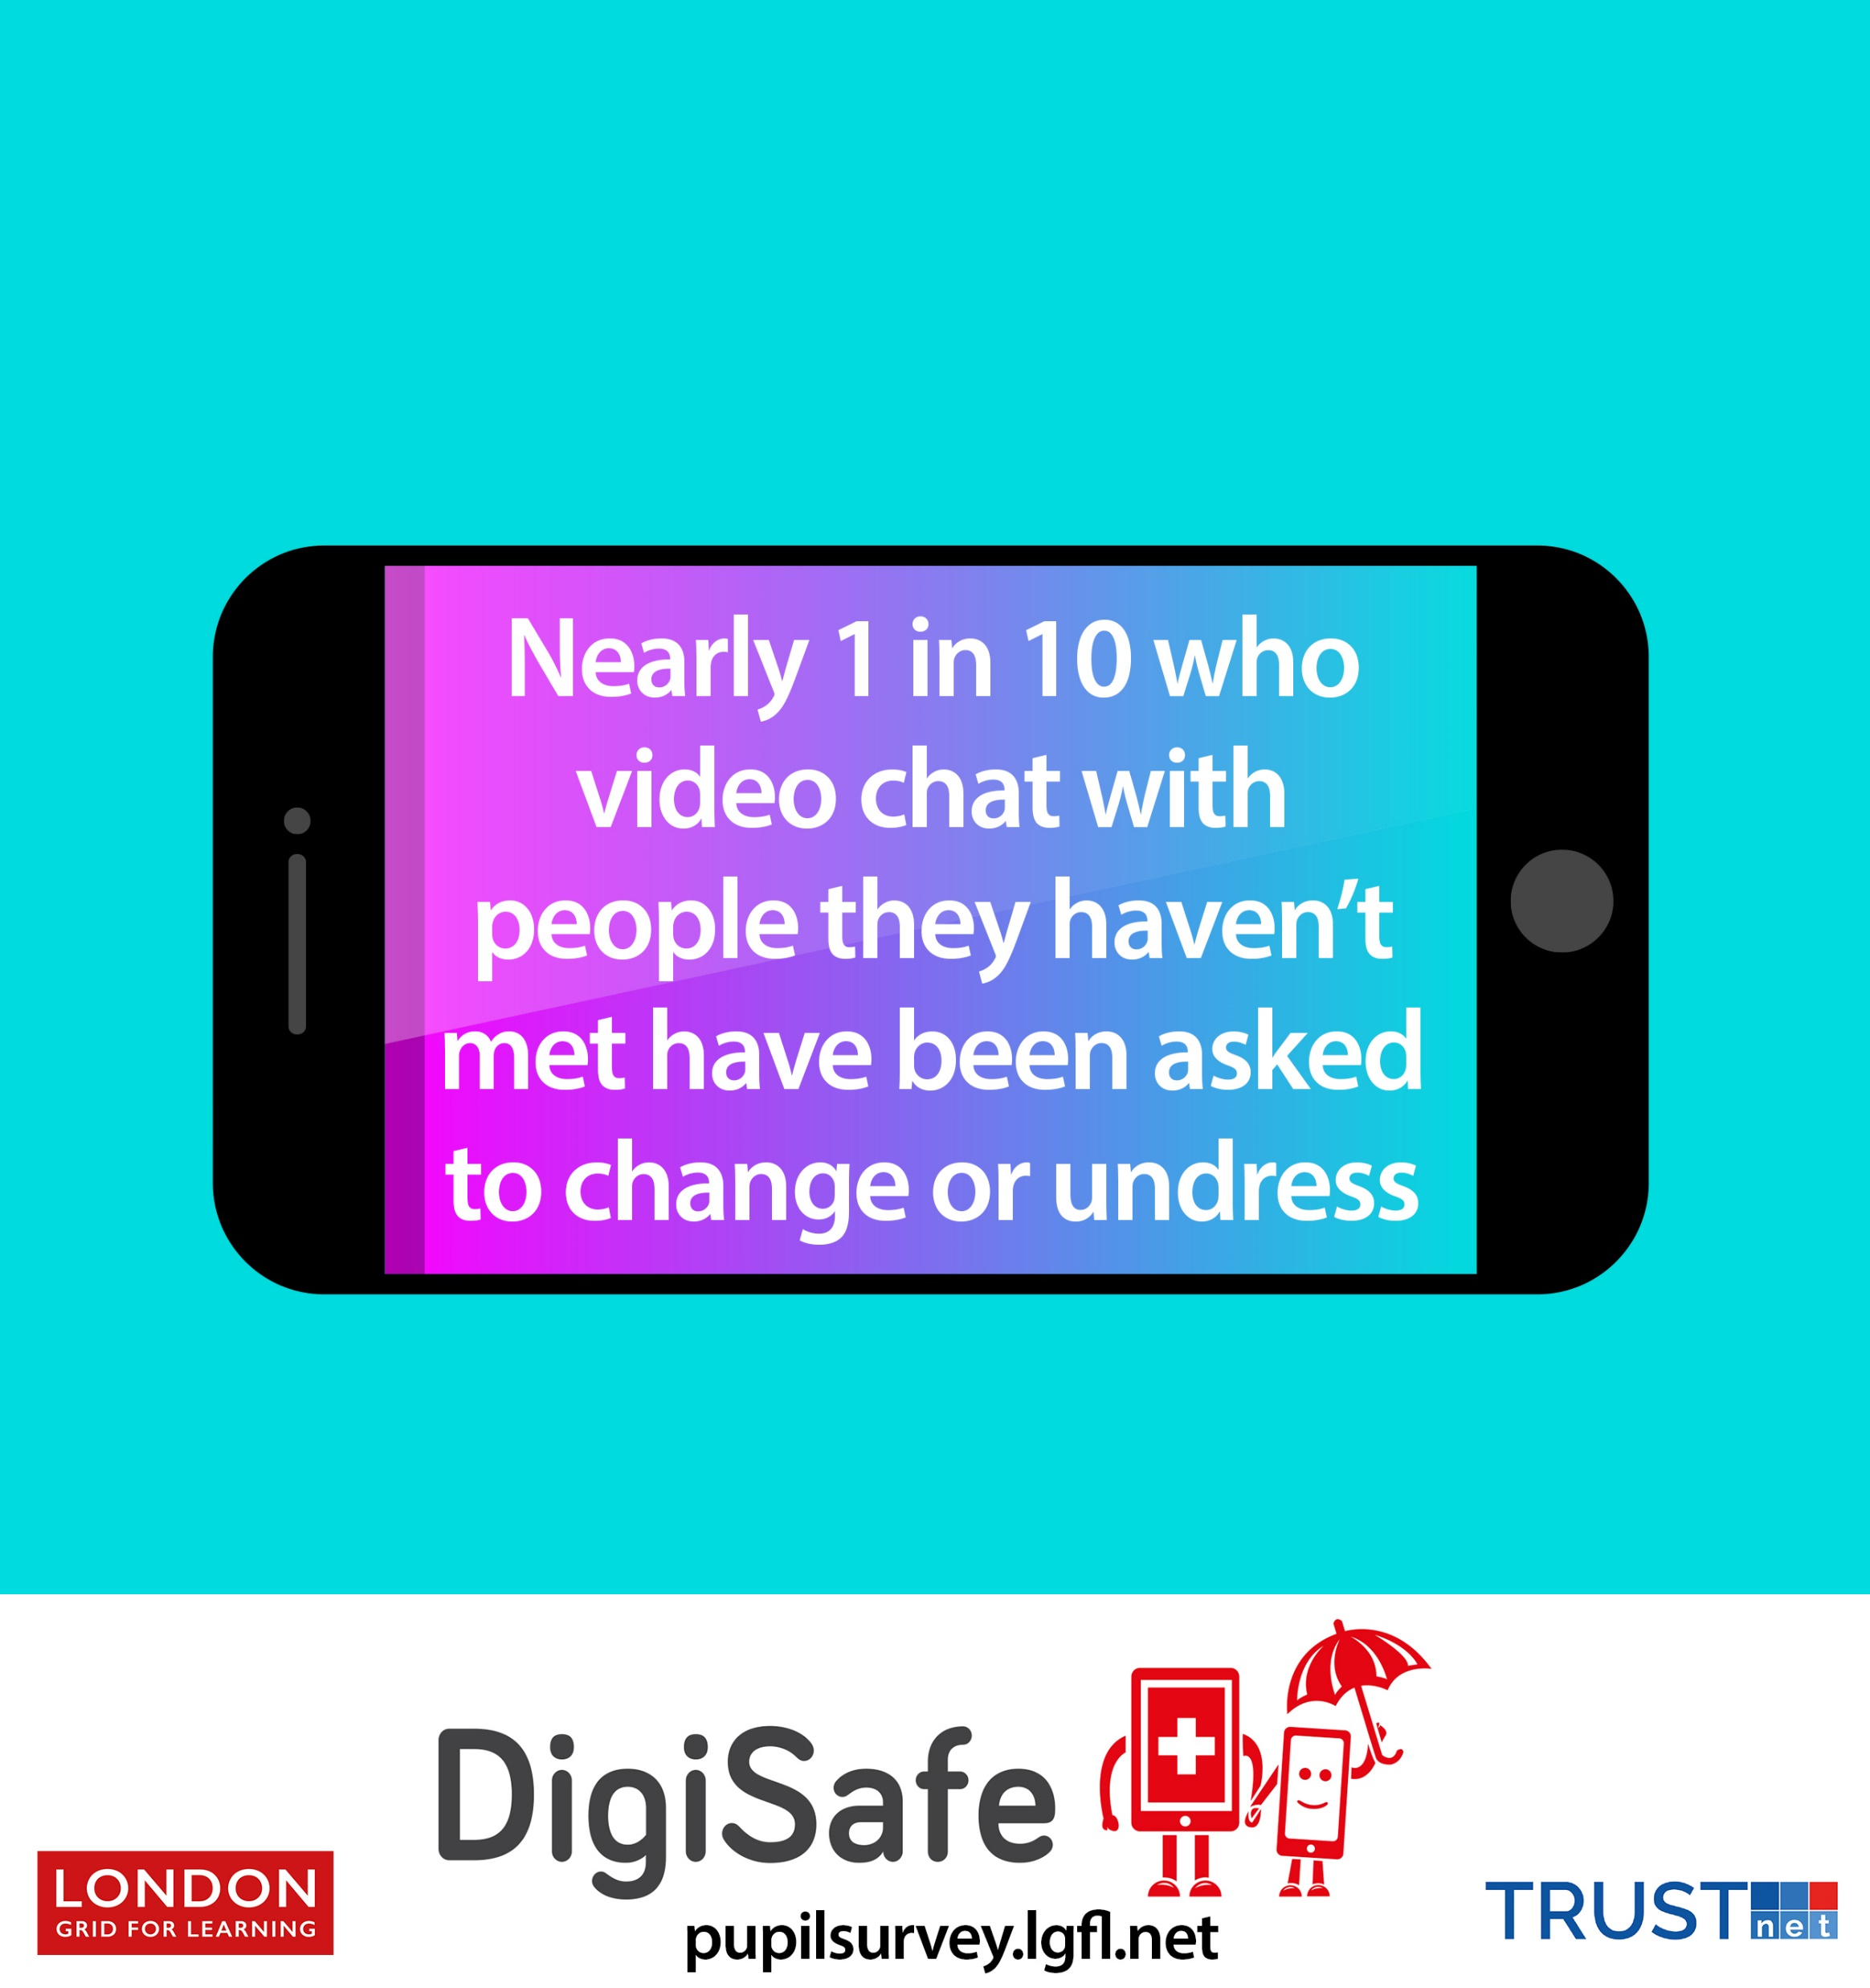
What about video chat? Will it be higher/lower/same?
Are you surprised that it is lower?
Should we work out which apps are worst and warn parents to stop using them?
The number will appear when you click through the presentation.
It is in the notes below
Notes:
** The missing number is “nearly 1 in 10”
Q7 – You may want to start with a discussion of what video chat is, and how it is not limited to dedicated apps like skype or hangouts, but is fully part of snapchat, facebook, whatsapp and many other apps, sites and games that aren’t even thought of as being for making contact with friends.
Ask colleagues to discuss with a partner
Q8 – x
Q9 – NO! Predators move around apps just as much as children do (a lot), so app warnings often lead to a false sense of security at best. See more on this issue and useful links within the report.

Slide 7
Discuss – how can we convey the message about not getting undressed on camera to pupils in our setting in a sensitive manner that will not upset them or cause parental concern (consider the oldest and the youngest yeargroups)?
Notes:
Q10 – This discussion is very important so allow time for this and you may wish to engage senior colleagues first.
Although your discussion will be very different if you are in a primary or secondary school because you can be a lot more open about the realities with older students, remember that the dangers are there for the oldest and youngest pupils, but older ones are more likely to be openly pressured (as well as be inadvertently tricked), whilst the youngest primary pupils may be tricked by a challenge to get changed really quickly, for example. Consider what parents will say in terms of how you couch the messaging, but bear in mind that these dangers are real for very young pupils.

Slide 8
Many other good and bad things can happen on streams – what do you think is the missing number here and what do you think those things might be?
The number will appear when you click through the presentation.
It is in the notes below
Notes:
Q11 – 1 in 6
Ask colleagues to suggest things that might happen that children do not like; come up with a list and then show the quotes on the next slide

Slide 9
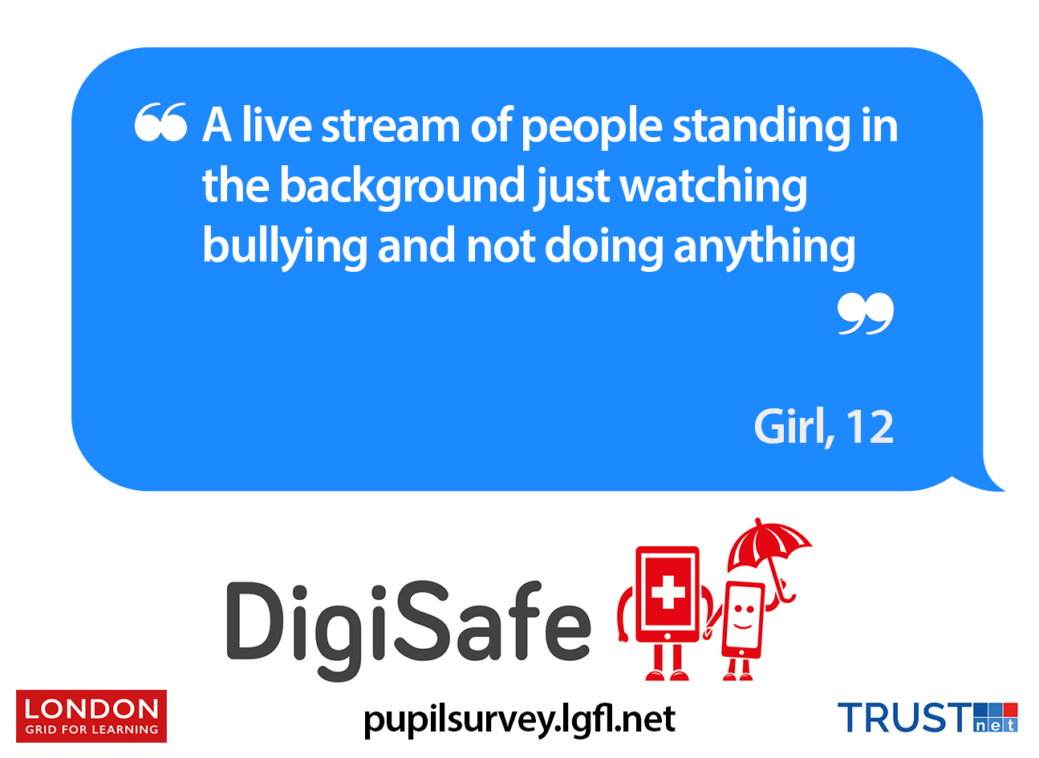
Notes:
Beyond sexual approaches, the children in our survey told us they were upset by violence, bullying and hate speech, and lots mentioned animals being hurt

Slide 10
Today we have focussed on some of the bad things, but it’s not all doom and gloom. There were many positives – what do you think pupils love about streaming, videochatting and their lives online in general?
How can we balance our messages to pupils and show we understand the positive aspects of livestreaming and life online?
The number will appear when you click through the presentation.
It is in the notes below
Notes:
Q12 - Give colleagues time for discussion and then show the quotes on the following slides. Pupils told us lots about the support they receive online and friendships that they would not make otherwise. And video chatting with relatives they do not see often has a very positive effect.
Q13 – For children and young people to accept warning messages, it is vital that these are couched in an understanding of the many positives of life online.

Slide 11
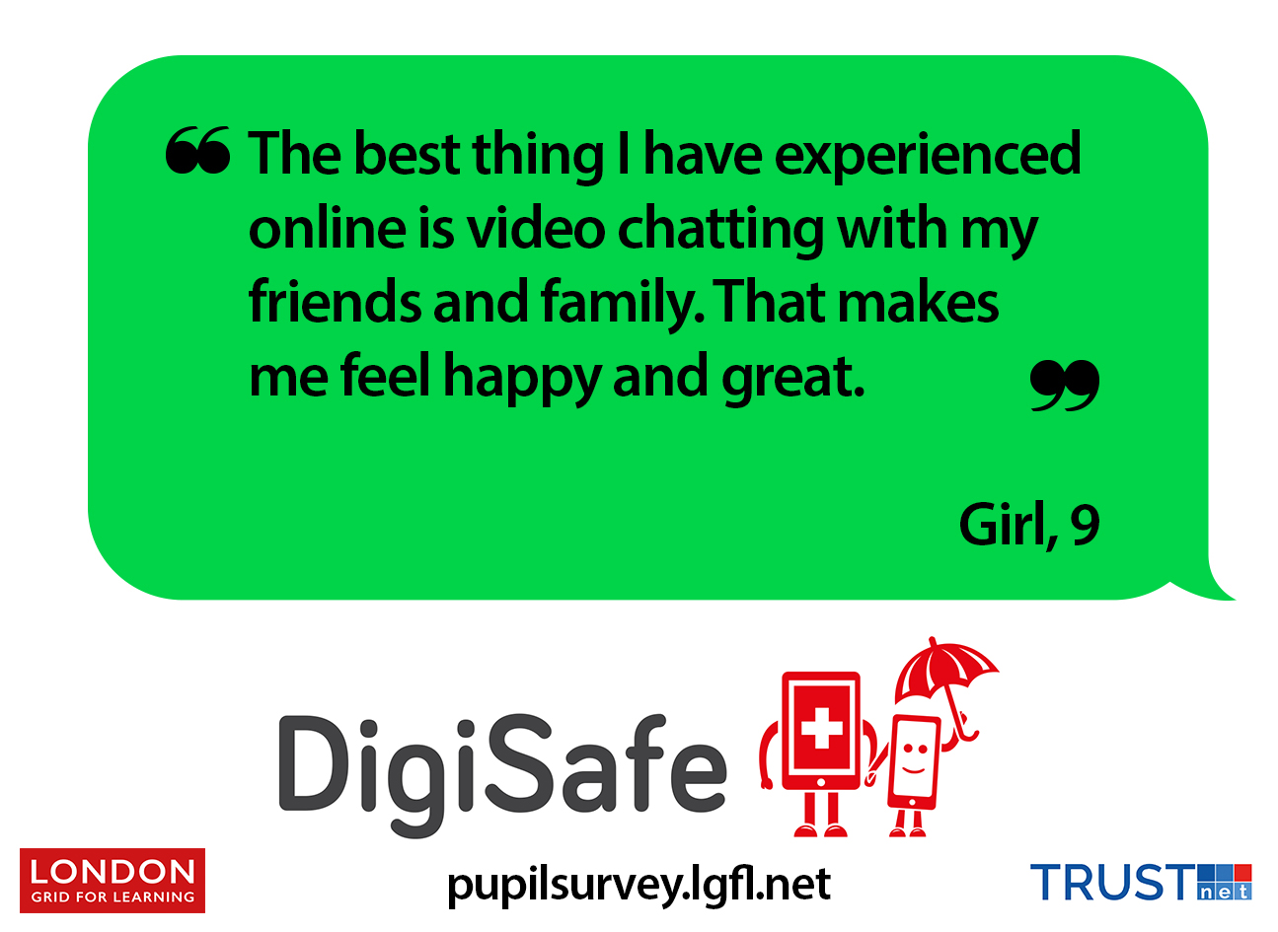
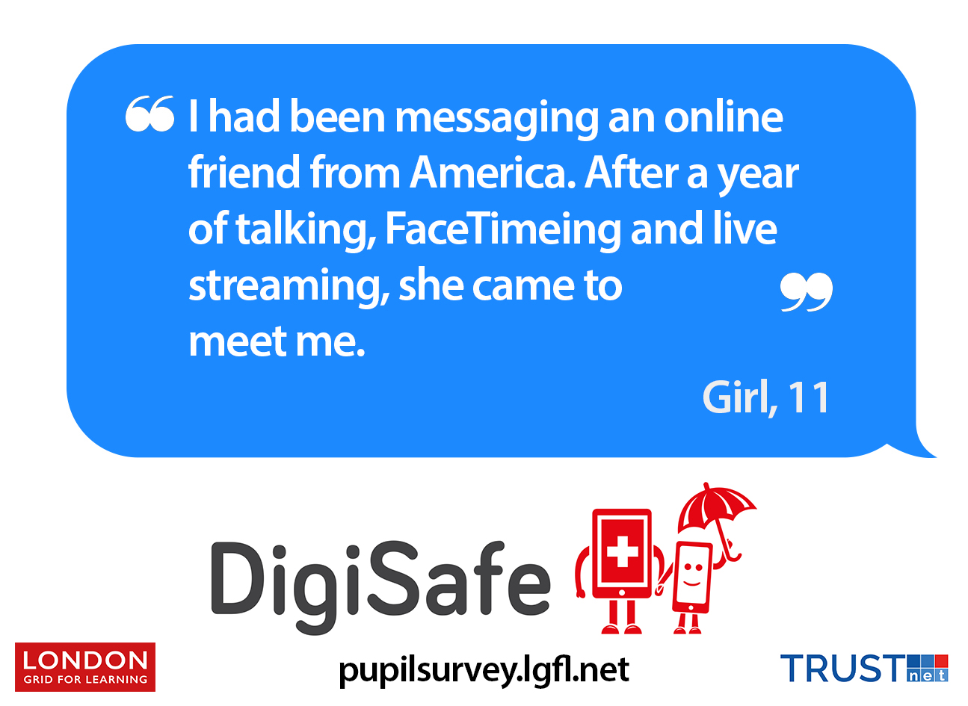

Slide 12
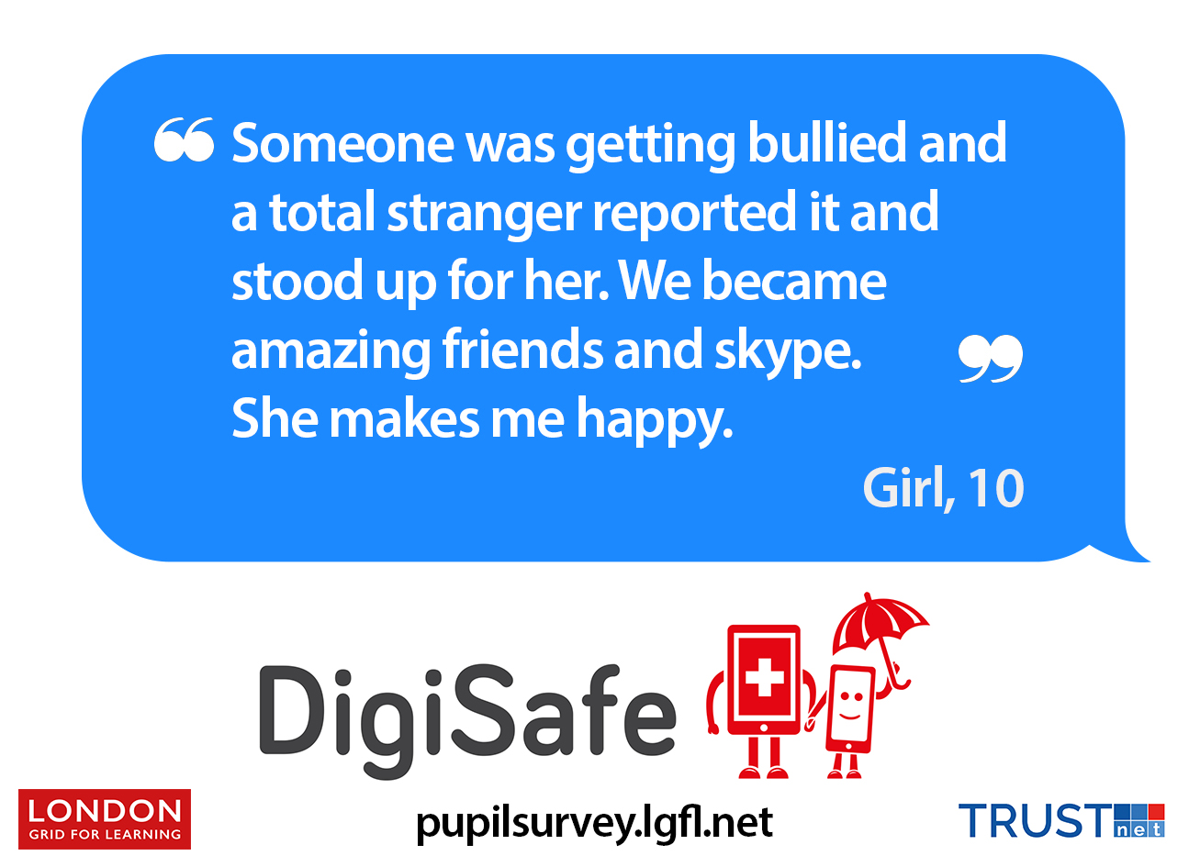

Slide 13
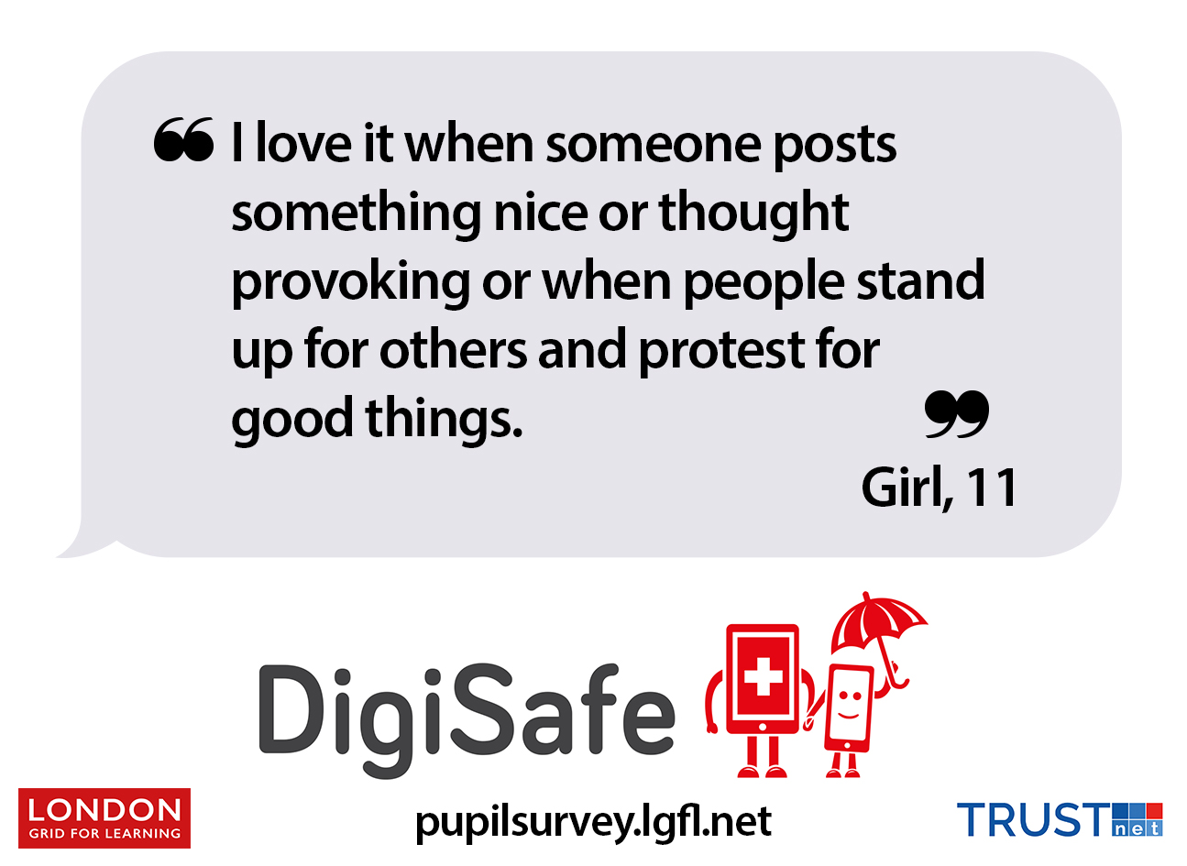

Slide 14
Hopes & Streams report pupilsurvey.lgfl.net
Livestreaming resources & signposting livestreaming.lgfl.net

