Slide 1
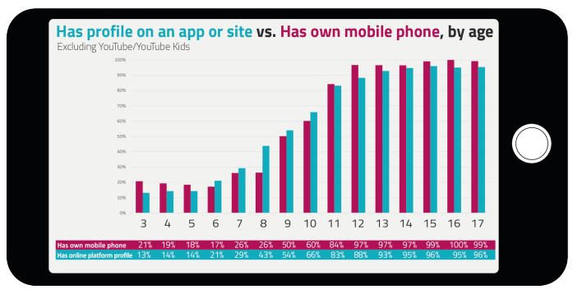
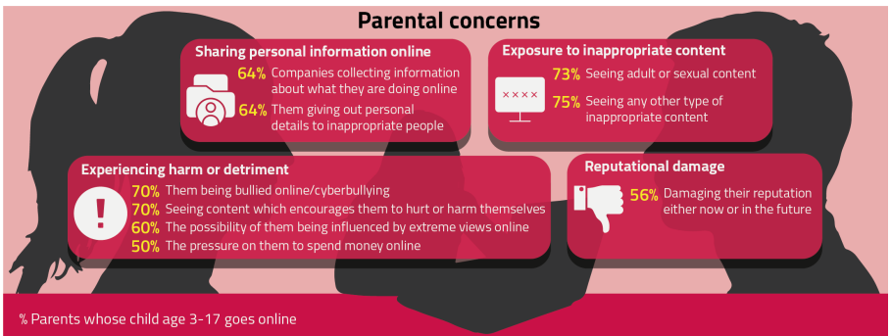
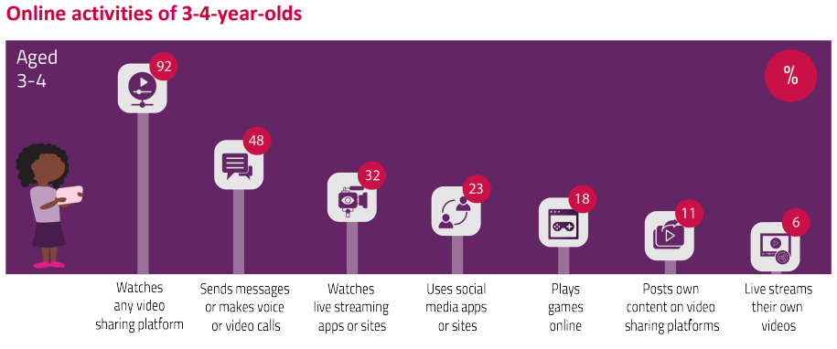
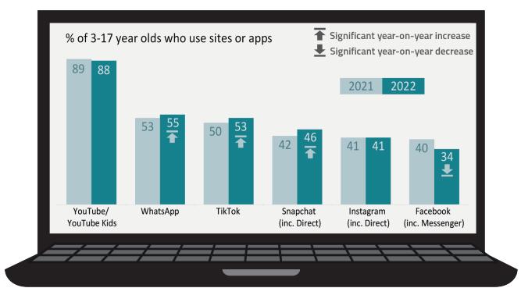
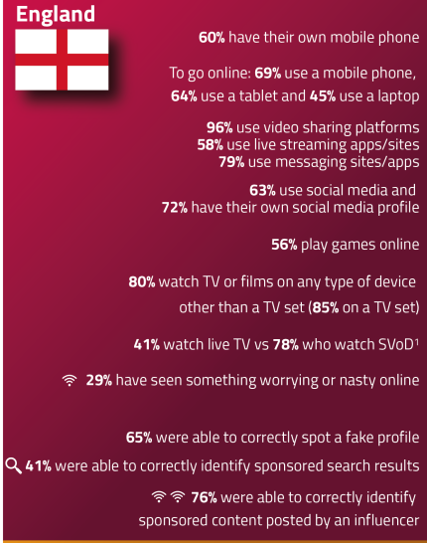
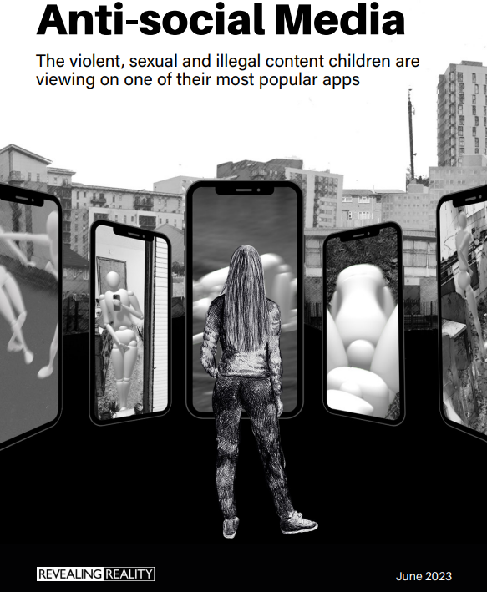
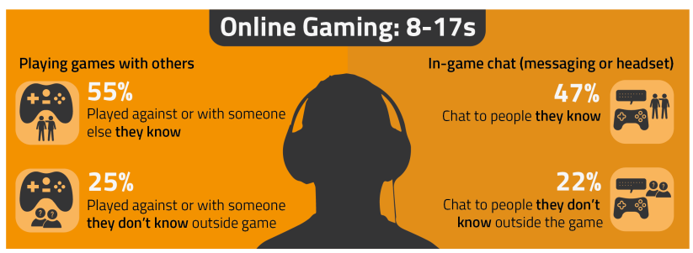
My child’s online life – parent discussion activities using Ofcom statistics by LGfL SafeguardED
Source: Children and parents: Media Use and Attitudes report 2023 and Revealing-Reality_Anti-social Media Report 2023
Notes:
This presentation brings together key findings from:
Children and parents: Media Use and Attitudes report - examines children’s media literacy, media use, attitudes and understanding among children and young people aged 5-15, as well as about the media access and use of young children aged 3-4., as well as parents’ views about their children’s media use, and the ways that parents seek – or decide not – to monitor or limit use of different types of media.
Revealing-Reality_Anti-social Media Report 2023
Along with suggested resources to empower parents to keep up with the latest trends/apps and games, manage controls and settings, and talk to children about risk - from bullying and sharing content, to extremism and gangs

Slide 2
This presentation brings together:
Key findings from Ofcom’s:
Children and parents: Media Use and Attitudes report - examines children’s media literacy, media use, attitudes and understanding among children and young people aged 3-15, as well as parents’ views about their children’s media use, and the ways that parents seek – or decide not – to monitor or limit use of different types of media.
Suggested resources to empower staff to help parents:
keep up with the latest trends, apps and games
manage controls and settings
talk to children about risk

Slide 3
Have you talked to your child about their life and experiences online?
Source: Children and parents: media use and attitudes report 2023

Slide 4
Are you familiar with the apps your child is on?
Go to apps.lgfl.net for guidance on apps and social media sites
YouTube was the most used site or app among children, visited by 88% 3-17-year-olds
This is not surprising, considering that 96% of 3-17-year-olds watch videos online
Source: Children and parents: media use and attitudes report 2023
Notes:
WhatsApp and TikTok were used by about half of 3-17-year-olds overall, and the data shows that the reach of WhatsApp, TikTok and Snapchat was higher in 2022 than in 2021. In contrast, use of Facebook among children aged 3-17 dipped from 40% in 2021 to 34% in 2022.

Slide 5
Do you know if the apps or sites your child is on are age appropriate?
84% of parents of 3-17s were aware of a minimum age requirement to have a profile on social media apps
ONLY
37% of parents stated the correct age requirement (13 yrs)
According to parents:
25% of children aged 3-4 used WhatsApp
54% of 8-11-year-olds
80% of 12-17-year-olds
Source: Children and parents: media use and attitudes report 2023
Notes:
For most social media platforms, the minimum age requirement is 13; however, our research showed that as the age of children increases, the use of different apps also increases. For example, 25% of children aged 3-4 used WhatsApp (according to their parents) compared to 54% of 8-11-year-olds and 80% of 12-17-year-olds
Mobile ownership increases with the age of the child and is almost universal by age 12, and the proportion of children who had their own profile on an online communications app or site grows alongside this.

Slide 6
Visit parentsafe.lgfl.net for tips and ideas to help parents:
Manage screen time
Set controls and settings
Understand apps and games
Talk to children about risk - from bullying and sharing content, to extremism and gangs

Slide 7
Have you set up parental controls/privacy settings for ALL devices/networks?
Visit www.internetmatters.org/parental-controls/ to find out how
Mobile phones (69%) and tablets (64%) were the most-used devices to go online among 3-17 year-olds
Older children (12-17-year-olds) were most likely to use mobile phones
those aged 3-11 were most likely to use a tablet
Source: Children and parents: media use and attitudes report 2023
Notes:
Ownership of mobile phones increases gradually up to age 8, when the rate of ownership accelerates to levels that are near-universal among children aged 12 and remains so into adulthood. This acceleration coincides with the move for many children from primary to secondary school, which occurs around age 11

Slide 8
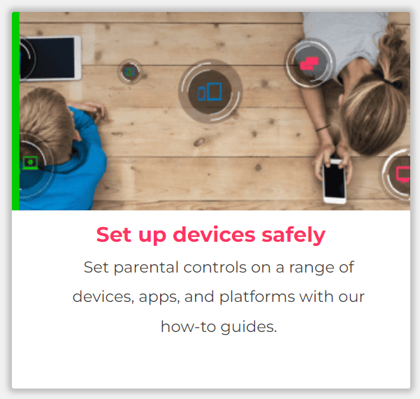
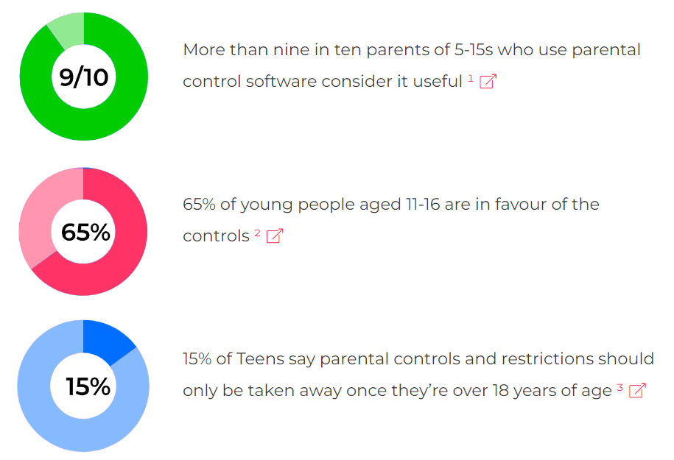
Visit www.internetmatters.org/parental-controls/ to find out how
Source: Children and parents: media use and attitudes report 2023
Notes:
Seven in ten parents of children aged 3-17 said they had some form of technical control in place to manage their child’s access to content online. Overall, the most-used technical controls were those that are built into the device by the manufacturer (34%). Parents were far less likely to use controls that required them to download specific software or apps. For example, only 13% of parents said they used security apps that can be installed on their child’s device to monitor the apps they use and for how long.

Slide 9
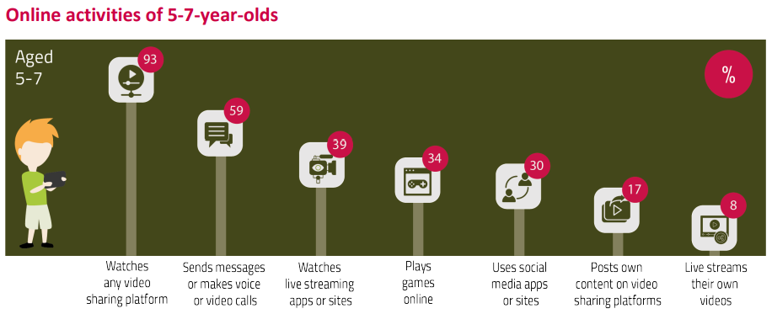
Do you talk to your child about the sites they use and what they share?
Know what they are watching?
Find conversation starters, story time ideas and top tips to reinforce key safety messages at parentsafe.lgfl.net
Source: Children and parents: media use and attitudes report 2020/21
Notes:
Consumption/parental supervision - two-thirds (65%) of parents of children aged 3-4 said they supervised what their child does online by sitting beside them and watching or helping them with what they are doing. Half of parents of children aged 3-4 reported that their main approach to online safety was to directly supervise their child, while 21% said their main approach was to talk to their child
Parents of 5-7-year-olds were most likely to monitor their child’s online activity by staying nearby and regularly checking (75%) or by asking their child about what they are doing online (59%). Although still supervising their child, parents do so at a greater distance than parents of younger children, with less than half (45%) sitting beside their child and watching or helping with what they do online. This suggests that children aged 5-7 were using devices more independently than those aged 3-4.

Slide 10
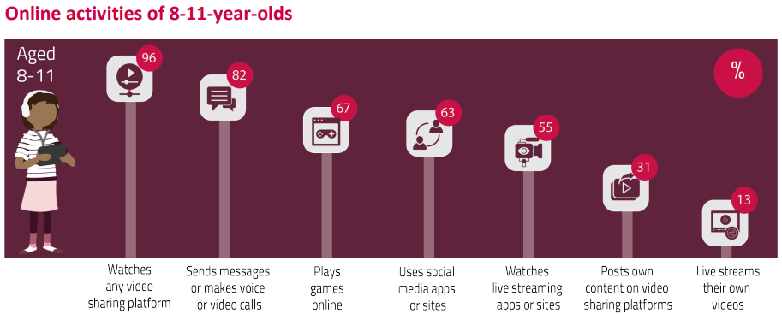
Did you know?
Most 8-11-year-olds had profiles on TikTok (32%) and WhatsApp (32%), ahead of YouTube (27%) and Snapchat (24%)
As with children aged 3-7, the most-used apps for sending messages or making calls were WhatsApp (54%) and FaceTime (32%)
However, 8-11-year-olds also used social media platforms for this activity, most commonly Snapchat (28%) and TikTok (26%)
Find conversation starters, story time ideas and top tips to reinforce key safety messages at parentsafe.lgfl.net
Source: Children and parents: media use and attitudes report 2020/21
Notes:
At this age there was less direct parental supervision of children’s online activities compared to younger age groups. Less than a quarter of parents (22%) said they sat beside their 8-11-year-old child and watched or helped with what they were doing online. Instead, more parents supervised their child’s online activity by asking their child (70%) or remaining nearby and regularly checking (69%) what they had been doing online.

Slide 11
Snapchat: ‘It’s our evening news’
Disturbing, graphic and illegal content:
Fights / beatings / stabbings / raids
Sexual assaults, sex acts involving children, CSAM
Sale of weapons and drugs online
(Some see this type of content several times a day, daily)
Wouldn’t consider reporting – seen what happens to a ‘grass’
While other children use Snapchat’s built-in filters to add funny effects to their selfies, the filter these children experience is the normalisation of humiliation, aggression, violence and crime
Source: Revealing-Reality: Anti-social-Media Report 2023
Notes:
Revealing Reality did this research to explore what some vulnerable children are seeing and doing on their phones
They’re not viewing this content on the dark web, finding it buried on hard-to-reach websites or through clandestine underground networks. They see it on mainstream social media and messaging platforms, primarily on Snapchat.

Slide 12
What about Parental Supervision by age?
3-4
Two-thirds (65%) supervised by sitting beside and watching or helping
5-7
Most likely to monitor online activity by staying nearby and regularly checking (75%) or by asking what they are doing (59%).
Half reported their main approach was to directly supervise their child
21% said their main approach was to talk to them
Although still supervising, parents do so at a greater distance, with less than half (45%) sitting beside their child and watching or helping them
This suggests devices being used more independently than aged 3-4
8-11
less direct parental supervision online compared to younger age groups
Less than a quarter (22%) sat beside their child and watched or helped
Instead, more supervised activity by asking their child (70%) or remaining nearby/regularly checking (69%) their activity
Source: Children and parents: media use and attitudes report 2023
Notes:
Less than three in ten parents of 3-17-year-olds (28%) believed the benefits of their child using social media, messaging and video-sharing apps or sites outweighed the risks
Parents of 3-11-year-olds were as likely as those of 12-15s to be concerned about companies collecting information (65% vs 63%); but were slightly more likely to be concerned about their child giving out personal information.
More than seven in ten parents of children aged 3-17 were concerned about their child seeing ageinappropriate content (75%) and or their child seeing ‘adult’ or sexual content online (73%). In contrast, fewer parents (49%) expressed concerns about the content their children were seeing on the TV programmes they watched
Seven in ten parents were concerned about their child seeing content online that would encourage them to harm themselves. Six in ten were worried about the possibility of their child being influenced by extreme views online, whether political, social or religious.
parents were concerned about their child being bullied in some way online or via communications technologies. For example, 70% of parents of 3-17-yearolds said they were worried about their child being bullied online, and about 54% of parents whose child played games online expressed concern about their child being bullied by other players while gaming. More than half of parents overall (52%) were worried about their child being bullied via calls, texts, emails, or messages on their mobile phone and parents of children aged 8-11 (55%) and 12-15 (57%) were more likely to have this concern than parents of 16-17-year-olds (40%).
Over half of parents (56%) said they were concerned that their child’s reputation might be damaged, either now or in the future, by their online behaviour..

Slide 13
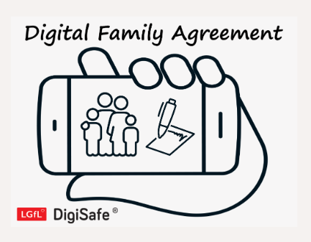
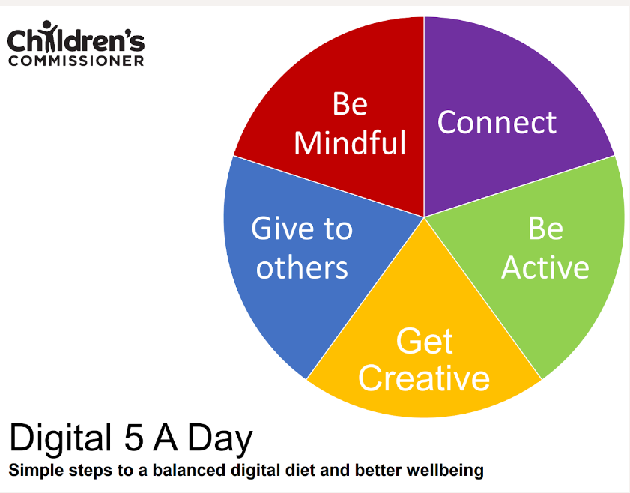
Find conversation starters, story time ideas and top tips to reinforce key safety messages at parentsafe.lgfl.net
Source: Children and parents: media use and attitudes report 2023
Notes:
Less than three in ten parents of 3-17-year-olds (28%) believed the benefits of their child using social media, messaging and video-sharing apps or sites outweighed the risks
Parents of 3-11-year-olds were as likely as those of 12-15s to be concerned about companies collecting information (65% vs 63%); but were slightly more likely to be concerned about their child giving out personal information.
More than seven in ten parents of children aged 3-17 were concerned about their child seeing ageinappropriate content (75%) and or their child seeing ‘adult’ or sexual content online (73%). In contrast, fewer parents (49%) expressed concerns about the content their children were seeing on the TV programmes they watched
Seven in ten parents were concerned about their child seeing content online that would encourage them to harm themselves. Six in ten were worried about the possibility of their child being influenced by extreme views online, whether political, social or religious.
parents were concerned about their child being bullied in some way online or via communications technologies. For example, 70% of parents of 3-17-yearolds said they were worried about their child being bullied online, and about 54% of parents whose child played games online expressed concern about their child being bullied by other players while gaming. More than half of parents overall (52%) were worried about their child being bullied via calls, texts, emails, or messages on their mobile phone and parents of children aged 8-11 (55%) and 12-15 (57%) were more likely to have this concern than parents of 16-17-year-olds (40%).
Over half of parents (56%) said they were concerned that their child’s reputation might be damaged, either now or in the future, by their online behaviour..

Slide 14
Summary of parental concerns (3 – 17 yr-olds)
Source: Children and parents: media use and attitudes report 2023
Notes:
Less than three in ten parents of 3-17-year-olds (28%) believed the benefits of their child using social media, messaging and video-sharing apps or sites outweighed the risks
Parents of 3-11-year-olds were as likely as those of 12-15s to be concerned about companies collecting information (65% vs 63%); but were slightly more likely to be concerned about their child giving out personal information.
More than seven in ten parents of children aged 3-17 were concerned about their child seeing ageinappropriate content (75%) and or their child seeing ‘adult’ or sexual content online (73%). In contrast, fewer parents (49%) expressed concerns about the content their children were seeing on the TV programmes they watched
Seven in ten parents were concerned about their child seeing content online that would encourage them to harm themselves. Six in ten were worried about the possibility of their child being influenced by extreme views online, whether political, social or religious.
parents were concerned about their child being bullied in some way online or via communications technologies. For example, 70% of parents of 3-17-yearolds said they were worried about their child being bullied online, and about 54% of parents whose child played games online expressed concern about their child being bullied by other players while gaming. More than half of parents overall (52%) were worried about their child being bullied via calls, texts, emails, or messages on their mobile phone and parents of children aged 8-11 (55%) and 12-15 (57%) were more likely to have this concern than parents of 16-17-year-olds (40%).
Over half of parents (56%) said they were concerned that their child’s reputation might be damaged, either now or in the future, by their online behaviour..

Slide 15
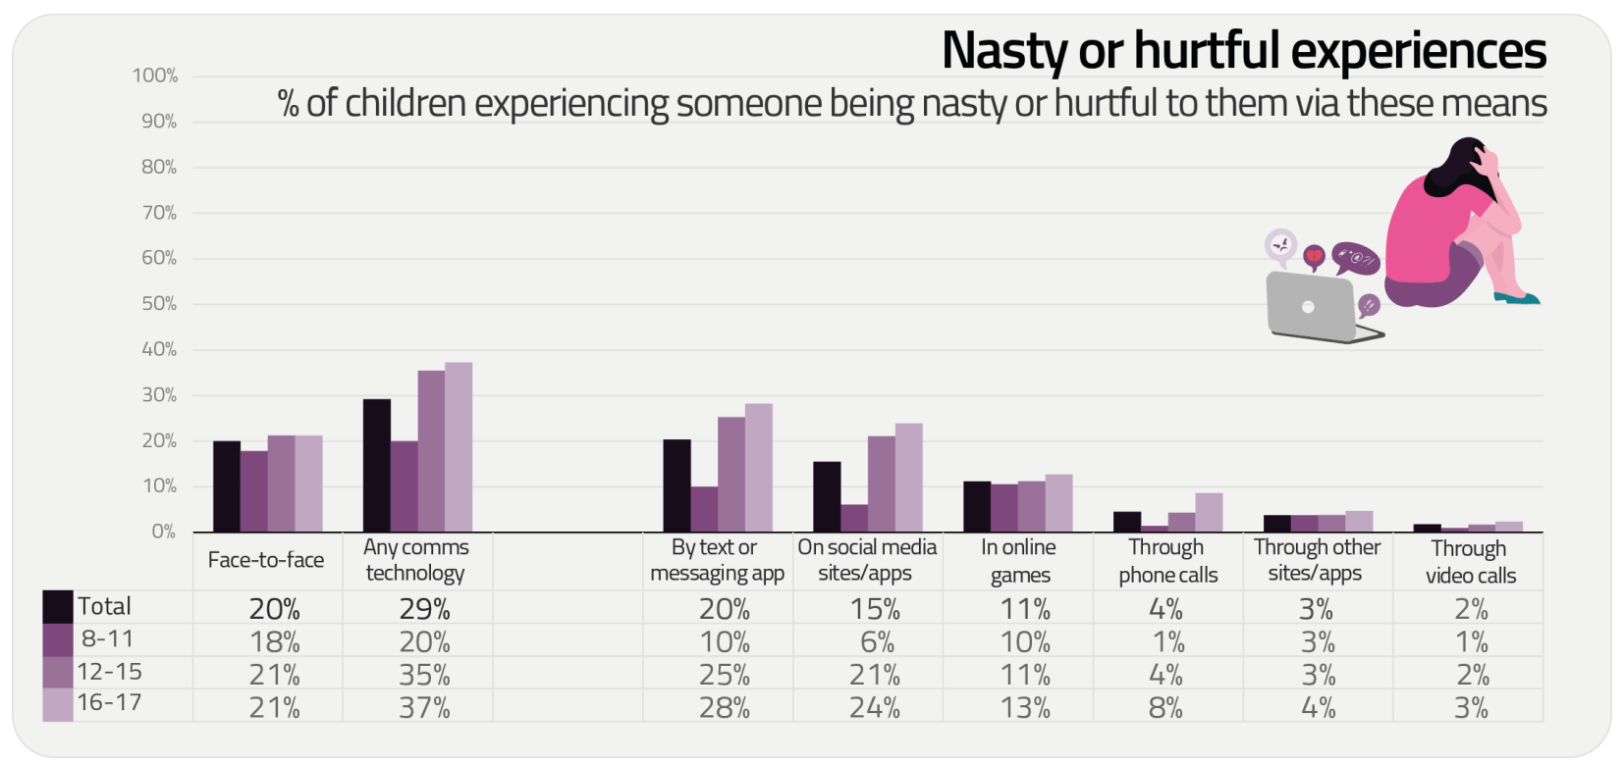
Summary of children’s negative experiences:
Source: Children and parents: media use and attitudes report 2023
Notes:
Almost three in ten children aged 8-17 (29%) had experienced a person being nasty or hurtful to them via a communication technology84, while two in ten had had a nasty or hurtful face-to-face experience. Those aged 12-15 (35%) and 16-17 (37%) were more likely to have experienced this than children aged 8-11 (20%). This year there was a decrease in 8-11-year-olds saying they had experienced someone being nasty or hurtful via comms technology, from 27% in 2021 to 20%.

Slide 16
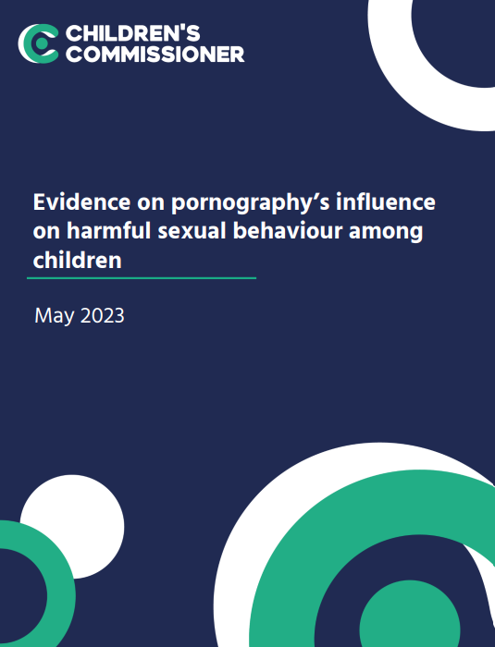
Average age children first view pornography is now 13 years old
Substantial proportions viewed it at a much younger age than 13 – 27% by age 11 and 10% by the age of 9
Unbearable pressure to view hardcore pornography even if they do not want to
Degrading acts and violence against women
Think it is reflective of real life or healthy relationships
Pornography sites are not the only way, or even the most popular way, that young people access online porn - wide prevalence of on social media platforms such as Twitter, Snapchat and Instagram
Source: https://www.childrenscommissioner.gov.uk/resource/pornography-and-harmful-sexual-behaviour/

Slide 17
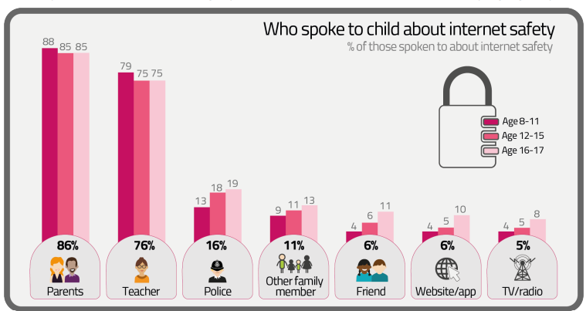
About nine in ten 8-17-year-olds (91%) had talked to someone about how to use the internet safely
88% had done so with any family member, usually a parent (86%).
Source: Children and parents: media use and attitudes report 2023
Notes:
Almost nine in ten (86%) parents said they had previously spoken to their child about how to stay safe online. This may have included talking about the potential dangers of content on sites or apps that might be unsuitable for their age, about sharing too much information online, and about contact with people they do not know. About half (47%) of parents who had talked to their child about how to stay safe online claimed to do so at least every few weeks.

Slide 18
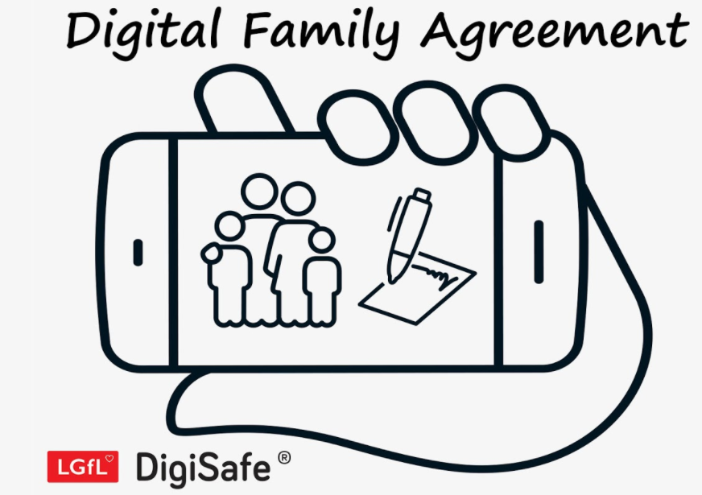
Why not have a family agreement to:
clarify what is allowed...or not
establish ground rules like no phones at the table or in the bedroom at night-time
agree shared expectations to reduce arguments and keep everyone safe & healthy
Download it at parentsafe.lgfl.net/digital-family-agreement
Source: Children and parents: media use and attitudes report 2023
Notes:
Half of parents talked to their child about online safety every few weeks Talking to children about online safety is another key mediation strategy, and nine in ten parents of children who went online said they had ever done this. Within this group, half talked to their child at least every few weeks; this was more likely among parents of the younger children aged 5-7 and 8- 11, than among parents of 12-15s. A further three in ten spoke to their child every few months, comparable between each age group. Fewer than one in five said they did it less often than this but had done so more than once.

Slide 19
Do they know who to talk to or how to report any concerns?
Most 8-11 yr olds told someone if they experienced something worrying
Tho thirds of 12-17 yr olds had blocked someone on social media (84% were aware of these functions)
A third had changed their settings so fewer people could see their profile
But only 14% had used a reporting/flagging function to report inappropriate content (35% were aware of these functions)
Go to reporting.lgfl.net to find out how to remove content from social media and where to report bullying, racial hatred, terrorism, sexual abuse and more
Source: Children and parents: media use and attitudes report 2023

Slide 20
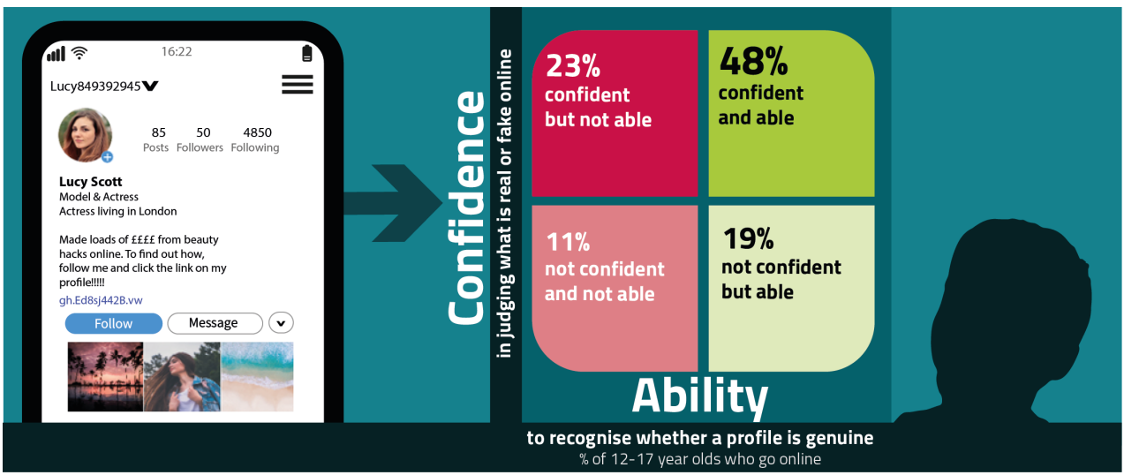
Do your children trust everything they see online?
Try our Critical Thinking Quiz at believe.lgfl.net
Source: Children and parents: media use and attitudes report 2023
Notes:
Seven in ten children aged 12-17 (70%) said that they were confident in their ability to judge what is real and what is fake online, rising to eight in ten (82%) 16-17-year-olds. The following graphic shows the relationship between the stated level of confidence of the child and their identification of the profile in our scenario as fake.
Twenty-three per cent of children aged 12-17 who had claimed to be confident in their ability to differentiate between real and fake online, failed to identify the profile as fake. Although this proportion was down from 27% in 2021, it still means that nearly a quarter were overconfident in their ability, and in a position of potential vulnerability

Slide 21
Are you familiar with who they are in contact with whilst playing games?
Visit gaming.lgfl.net for advice and activities to keep them safe
Source: Children and parents: media use and attitudes report 2023
Notes:
Online gaming provides the opportunity for children to communicate with others, either through playing or via in-game chat or messaging. Three-quarters of children aged 8-17 (72%) played games online. A quarter of children this age played games online with people they don’t know, while 22% chatted to people they don’t know when gaming.
Among children’s media activities, however, video gaming ranks very highly. Nine in ten children aged 3-17 (89%) played video games using any of the devices listed in the graphic below, and of all the media activities we measure, only watching videos on VSPs (96%) and watching TV (97%) were more widespread. An exception to this is that children aged 3-4 were less likely to be playing video games (70%); this has declined from 81% year on year. Most children were gaming using a console (59%), followed by a mobile phone (49%) and a tablet (43%). Devices used for gaming varied by the age of child, as did the types of game played, but overall use of tablets for gaming declined year on year (from 50% to 43%) as did the use of desktop/ laptop computers (from 31% to 25%)

Slide 22
29% of 8-17s had seen something they found worrying or nasty online in the past 12 months
60% of parents were concerned about them seeing extremist content
Visit goingtoofar.lgfl.net to find out how to:
recognise extremist behaviour and content on social media/apps/games
understand actions likely to attract police investigation
get help
report concerns
Source: Children and parents: media use and attitudes report 2023
Notes:
In 2021, just under one in ten 12-15s said they often saw ‘hateful content’ online For the purposes of our survey, we described ‘hateful content’ as anything that had been directed at a particular group of people based on, for instance, their gender, religion, disability, sexuality, or gender identity. Overall, half of 12-15s said they had encountered this type of content online in the past year, with 8% saying that they had seen it often.

Slide 23
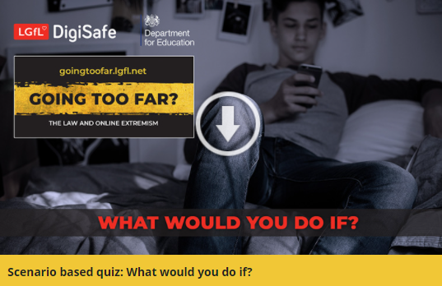
Are they aware of the implications their actions could have?
Could they be breaking the law?
Or putting themselves or others at risk?
Visit goingtoofar.lgfl.net to find out more.
Why not take the quiz together at takingastand.lgfl.net
Source: Children and parents: media use and attitudes report 2020/21
Notes:
In 2021 - Children had adopted different strategies for dealing with hateful content. Six in ten 12-15 year-olds said they had taken some action on seeing it. But some, depending on their actions, might have inadvertently shared the content further. Around a fifth said they had responded to the post/video/comment by ‘disliking’ it or commented on it to say they thought it was wrong, or shared it with their friends, saying it was wrong. Doing this brings the risk that their action will appear in their own social media feed, which is then seen by others, inadvertently further sharing the content. Meanwhile, 25% chose to block the person who shared or made the comments, while 22% reported it to the website. Although girls aged 12-15 were more likely than boys to inadvertently share the content by disliking the post/comment/video (27% vs. 13%), they were also more likely than boys to take constructive action in reporting the content to the website (33% vs. 10%).

