Slide 1
Staff Inset / CPD materials from
LGfL DigiSafe on
‘SELF-HARM
BULLYING’
Based on the Hopes & Streams report into the 2018 pupil online safety survey of 40,000 pupils across the UK: pupilsurvey.lgfl.net
* These slides cover issues which should be presented within a safeguarding training context, by / in consultation with your designated safeguarding / mental health lead

Slide 2
Feel free to edit this PowerPoint to meet the needs of your school staff but please do not try to edit the graphics or remove the brand logos or weblinks.
We would love to hear how you use this / if it’s useful, how we can improve it and what else we can do to support you – get in touch with @LGfLDigiSafe on Facebook or Twitter
NB: There are notes on each slide – including this one – to help the presenter.
Hopes & Streams report: pupilsurvey.lgfl.net
Online safety / safeguarding resources & signposting: saferesources.lgfl.net
Notes:
BEFORE running a session for staff with these slides:
Speak to your DSL / mental health lead / SLT; this should not be the only time staff hear about self-harm or bullying – this is not intended as a comprehensive introduction to the general topics, but to look specifically at ‘self-harm bullying’
This training should be part of a planned and considered CPD programme and never used as a ‘filler’, especially given its sensitive nature / subject matter. Remember that this is an emotive subject for all staff, and some staff may be parents of children who self-harm, and/or have been affected themselves.
Be sure to first read at least the relevant section (‘Mental health, self-harm & bullying’ on p.38) of the Hopes & Streams report at https://pupilsurvey.lgfl.net – there are links to general teacher guidance on these topics. For example, you could ask colleagues to watch the video there first before coming to your session.
There is also an open-access LGfL Healthy Minds resource with a section on Self-Harm – you could ask colleagues to read the document or watch the video (marked ‘for professionals’) in advance of the session from this page: http://healthyminds.lgfl.org.uk/no-harm.html
DO NOT ask pupils about self-harm to replicate statistics here (or similar questions to elicit disclosures) without talking first to your DSL and ensuring the right frameworks are in place to support potential disclosures.
Stress the same point to staff.
If your school took part in the survey, however, you will have been sent returns for your school which you may wish to share with staff.
These slides cover a quite specific area – please treat this session in the context of your whole-school approach, policy and strategy to both mental health and bullying, which will require broader training.

Slide 3
Presenter –see slide notes
Notes:
Please take time before beginning to say that the issues in this training may well be upsetting. Be sure to announce the subject in advance of the session to allow staff to mentally prepare. Follow the usual procedures to remind staff that they can leave the room if they need to, and give them the opportunity to talk about any issues which may arise afterwards.
It is quite likely that self-harm will already personally affect a number of staff in any school (e.g. regarding their own mental health history or that of children or other family members/friends).
It is also likely to be distressing for other staff. Accordingly, do not deliver this training without discussing with the designated safeguarding lead (if that is not you), as s/he will be used to the precautions needed before covering sensitive issues like this, e.g. not rushing through and immediately dispatching staff to deliver a full day of lessons without the chance to process / discuss any issues.

Slide 4
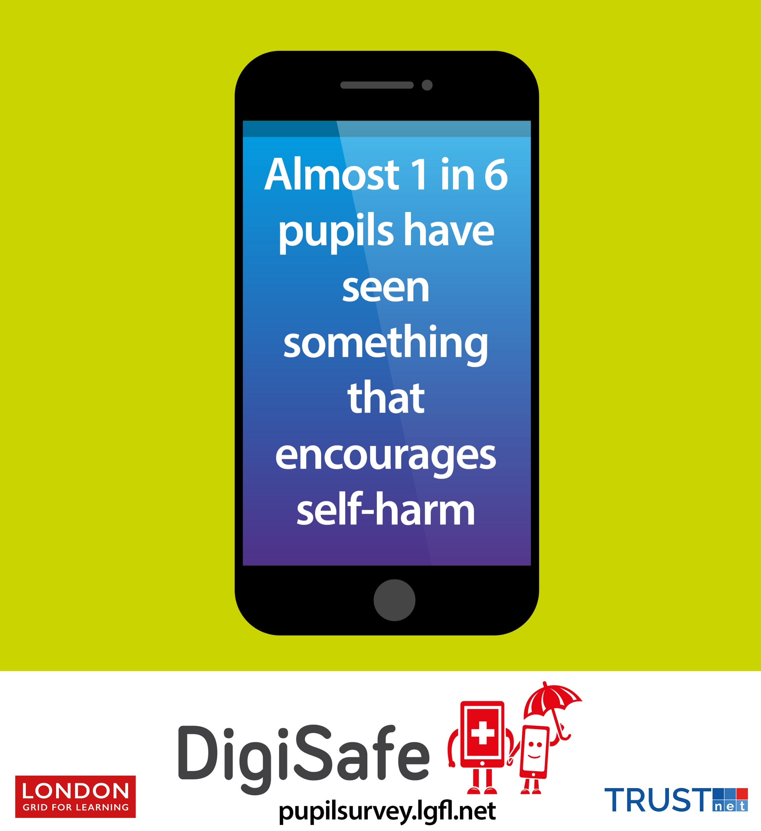
NB: This PPT includes animations; you need to play it to see it in action – e.g. questions appear one by one and the blanked out figures appear as you click through. This message will not appear when you run the presentation.
What might the ‘something’ they have seen be? An image, or text or…?
What do you think the missing number is? Discuss in pairs.
Make sure you have the notes section visible as answers and suggestions are there for the person leading the inset.
Notes:
Q1 – The exact wording of the question we asked was “Have you ever seen anything that encourages people to hurt themselves?”
The free-text comments revealed that it could be text (quote on slide 6 reveals what it might be), photos, videos, websites. Often a combination – as the quote on slide 6 shows.
Q2 – the answer appears on the next slide (Almost 1 in 6, which was 17.4% of the 40,000 pupils questioned)

Slide 5
Does the number surprise you? Why?
Is this more of a secondary problem than a primary one?
What about a ‘girls problem’ or a ‘boys problem’?
Notes:
Q3 – x
Q4 – Not really, no – 16.3% (Primary) vs 18.7% (Secondary). It’s really important to take this seriously in both phases. You could ask colleagues to consider different approaches for different age groups in your setting.
Q5 – The quote marks in the question are deliberate as it is important not to think of issues as specifically a boy or a girl problem. Be sure to highlight this. Any case is significant and needs consideration.
In Primary, there is little difference (15% vs 16%);
In secondary, the gap widens (15.4% for boys and 20% for girls). Ask colleagues to consider why there might be a difference, but remind them that 15.4% of boys is a significant number and must not be underestimated.).

Slide 6
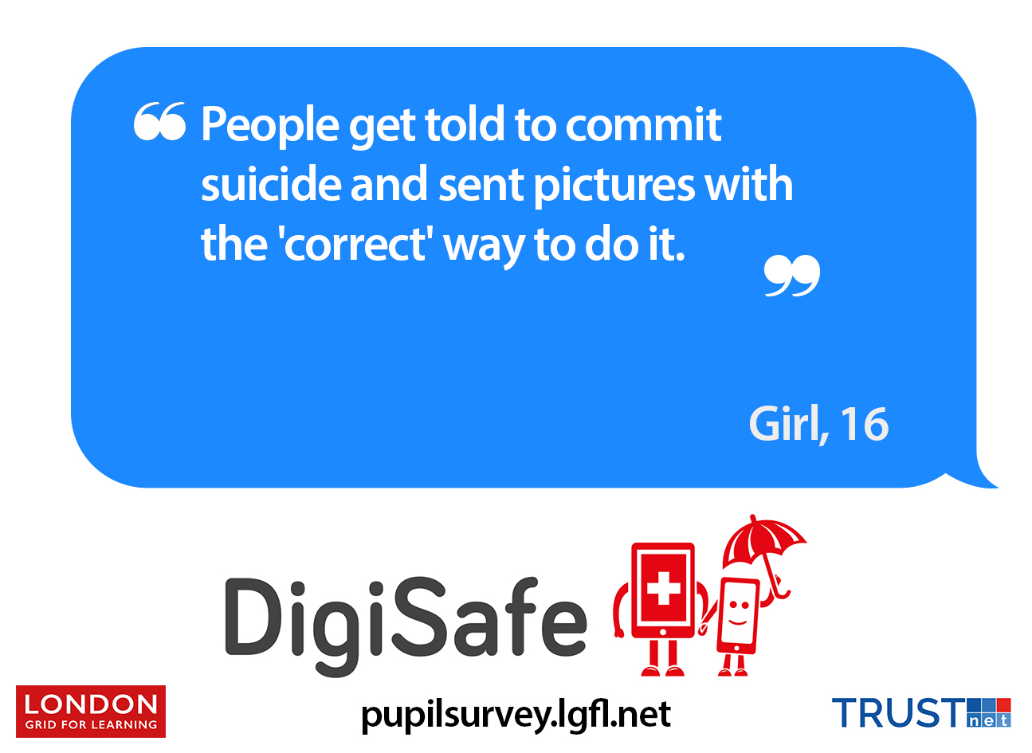
If someone said “Go kill yourself?” in the playground, it would be upsetting? Why might it be worse via technology?
As if this isn’t bad enough, how might this quote end?
Notes:
Q6 – Whilst it may be upsetting to dwell on this question, it is important to recognize that whilst some people might brush off a single comment, often online bullying has a multiplying impact, coming into the home via a phone notification, sometimes again and again or from different people, and which you cannot get away from. What about if you receive it on your own, late at night / when you think you have left school / bullies behind.
Q7 - Ask this as a rhetorical question and reveal the answer swiftly (by clicking ‘next’) rather than give time to think about options – that would achieve nothing other than potentially upset staff.

Slide 7
Would this happen with our pupils?
Would the pupils/ students you teach be likely to tell someone at home/ school if they were sent this?
What would you do if you were told this?
Notes:
Q8 – This is a bit of a trick question; alarm bells should ring if you hear ‘no’. Keeping Children Safe in Education page 7 “Staff members working with children are advised to maintain an attitude of ‘it could happen here’”
Please point out that this survey was run across the UK with 40,000 pupils, across all demographics. Whilst the quote is from a 16 year old girl, there were similar answers from younger pupils, and from boys too.
Q9 – x (if they answer no, what could you do to change this?)
Q10 – Please ask your DSL/mental health lead for the wording to support this answer, which is all about ‘following school safeguarding procedures’. How does it fit into your anti-bullying / mental health strategy / policy?

Slide 8
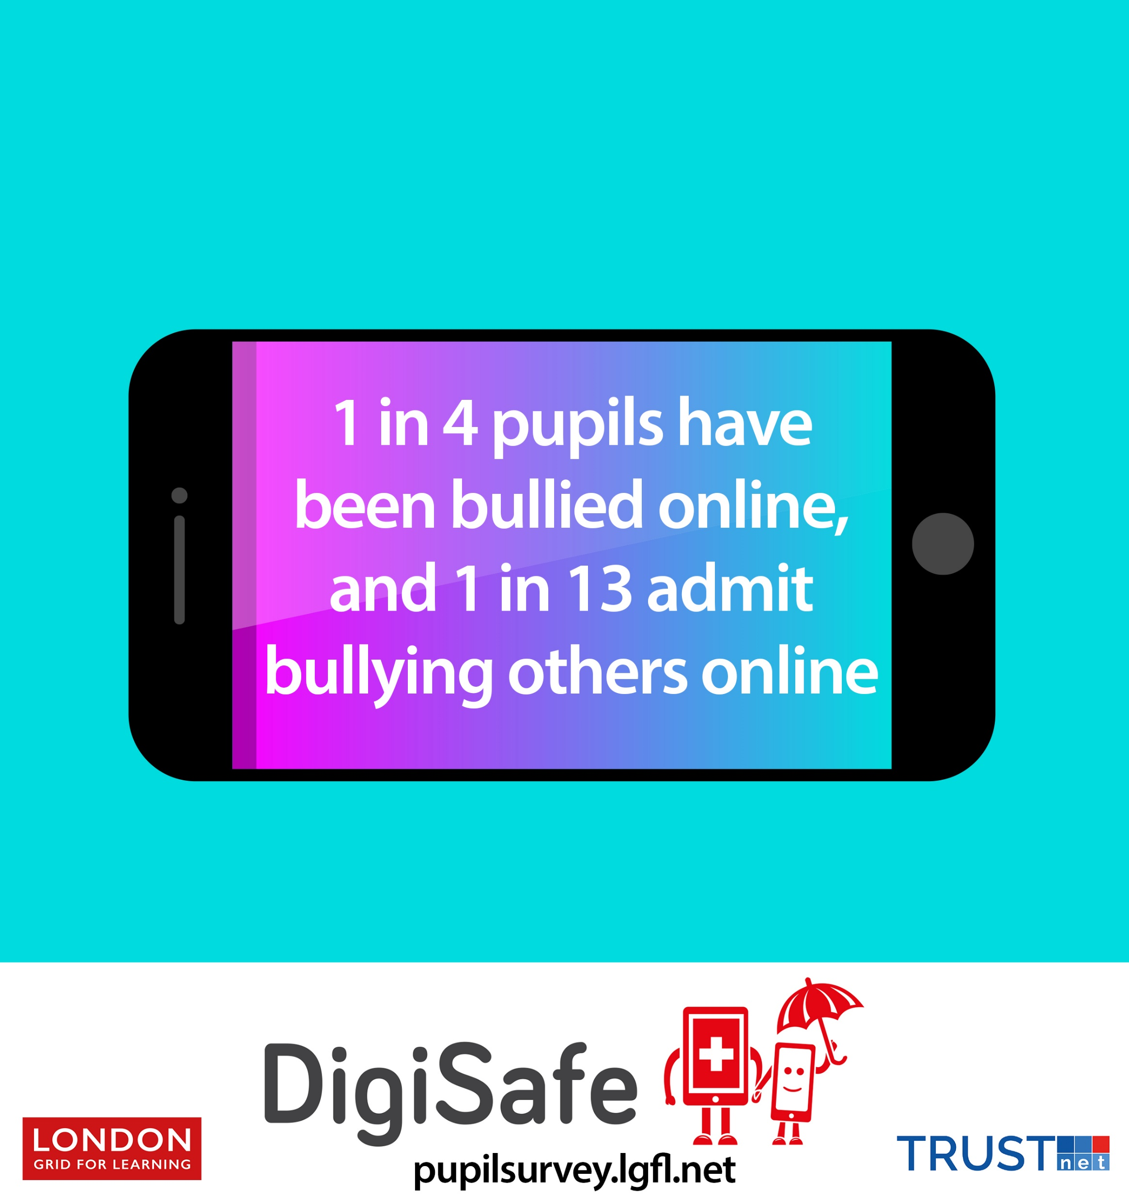
Notes:
This statistic is to put self-harm bullying into the broader context of bullying. You may wish to discuss or simply show this statistic.
Perhaps also relevant are the numbers of pupils who had sent or received violent images or videos (which may or may not relate to self-harm, but the volume of free-text comments relating to self-harm showed that this was a major issue): 15% of all pupils had seen/received violent images/videos; 6% admitted to having sent these.

Slide 9
Today we have focussed on some of the bad things, but it’s not all doom and gloom. There were many positives – what do you think pupils love about their online lives relating to mental health and self harm?
Notes:
Q12 - Give colleagues time for discussion and then show the quotes on the following slides. Pupils told us lots about the support they receive online and friendships that they would not make otherwise. It is important that as adults we show we understand these positives if we want children and young people to listen to us when we talk about the risks/dangers.
If you want to know more about the positives, there are more in the report – see https://pupilsurvey.lgfl.net

Slide 10
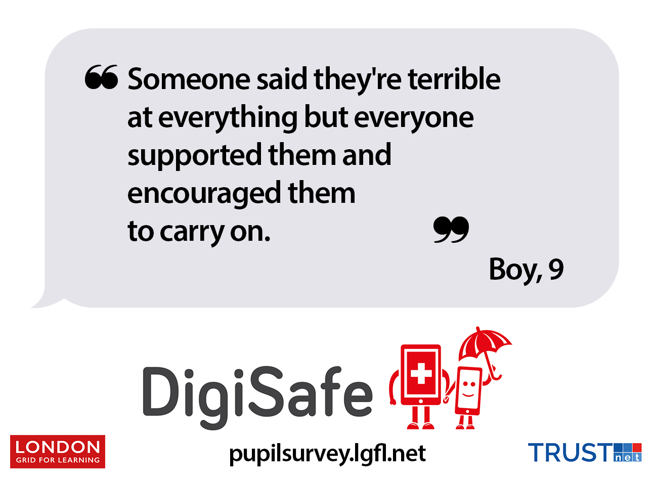

Slide 12
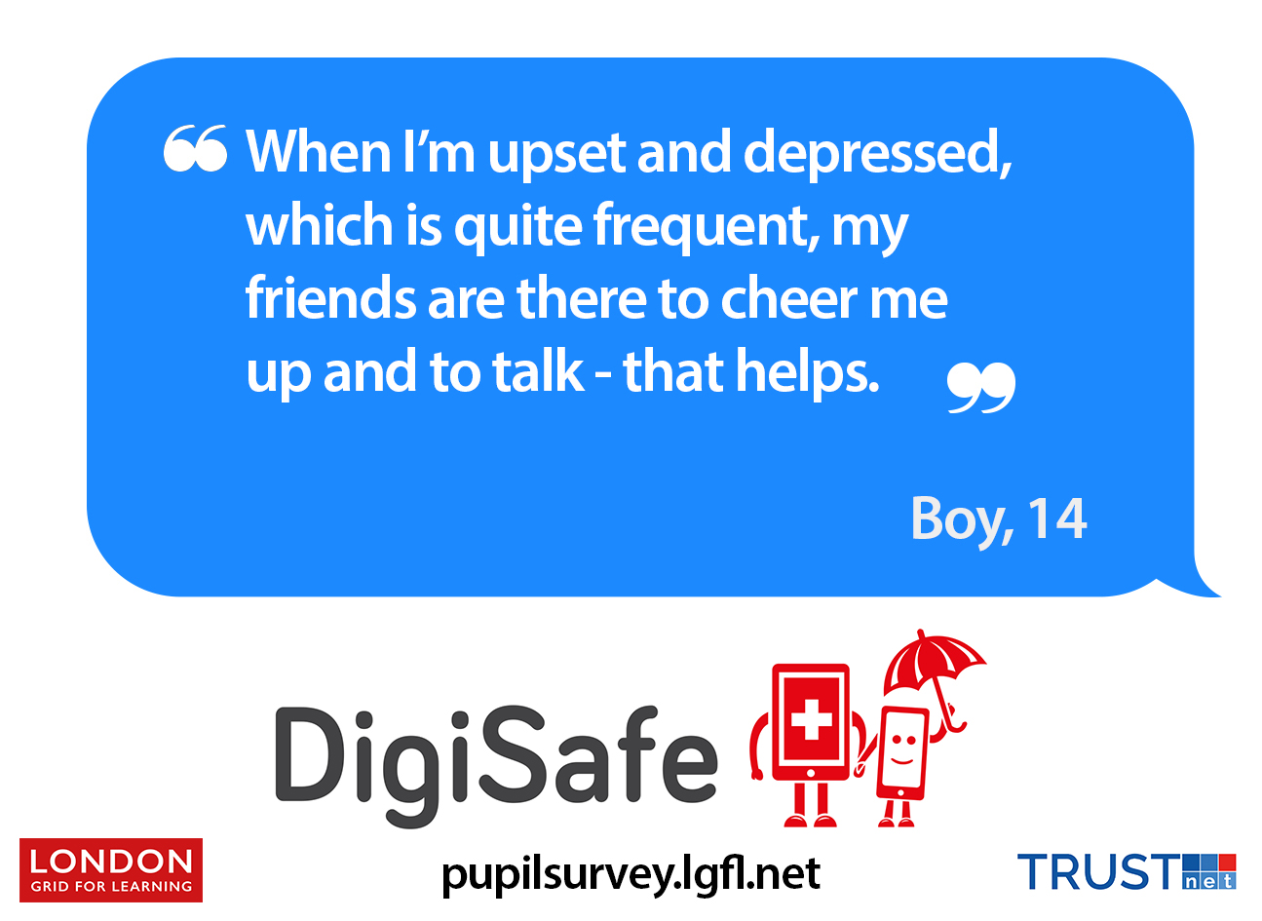

Slide 13
What can we do to improve upstanding and reporting to help pupils cope with these issues?
Notes:
12 – This discussion point will have no ‘correct’ answer, but check staff know what is meant by upstanding (anti-bullying term which contrasts a bystander with someone who stands up for someone, making them an upstander).
There are various reporting channels available at reporting.lgfl.net.
What are the internal ways to report issues (for staff and/or pupils) at your school? Are they well used / how could they be improved?
It may be worth also considering whether your policies need updating to consider self-harm bullying.

Slide 14
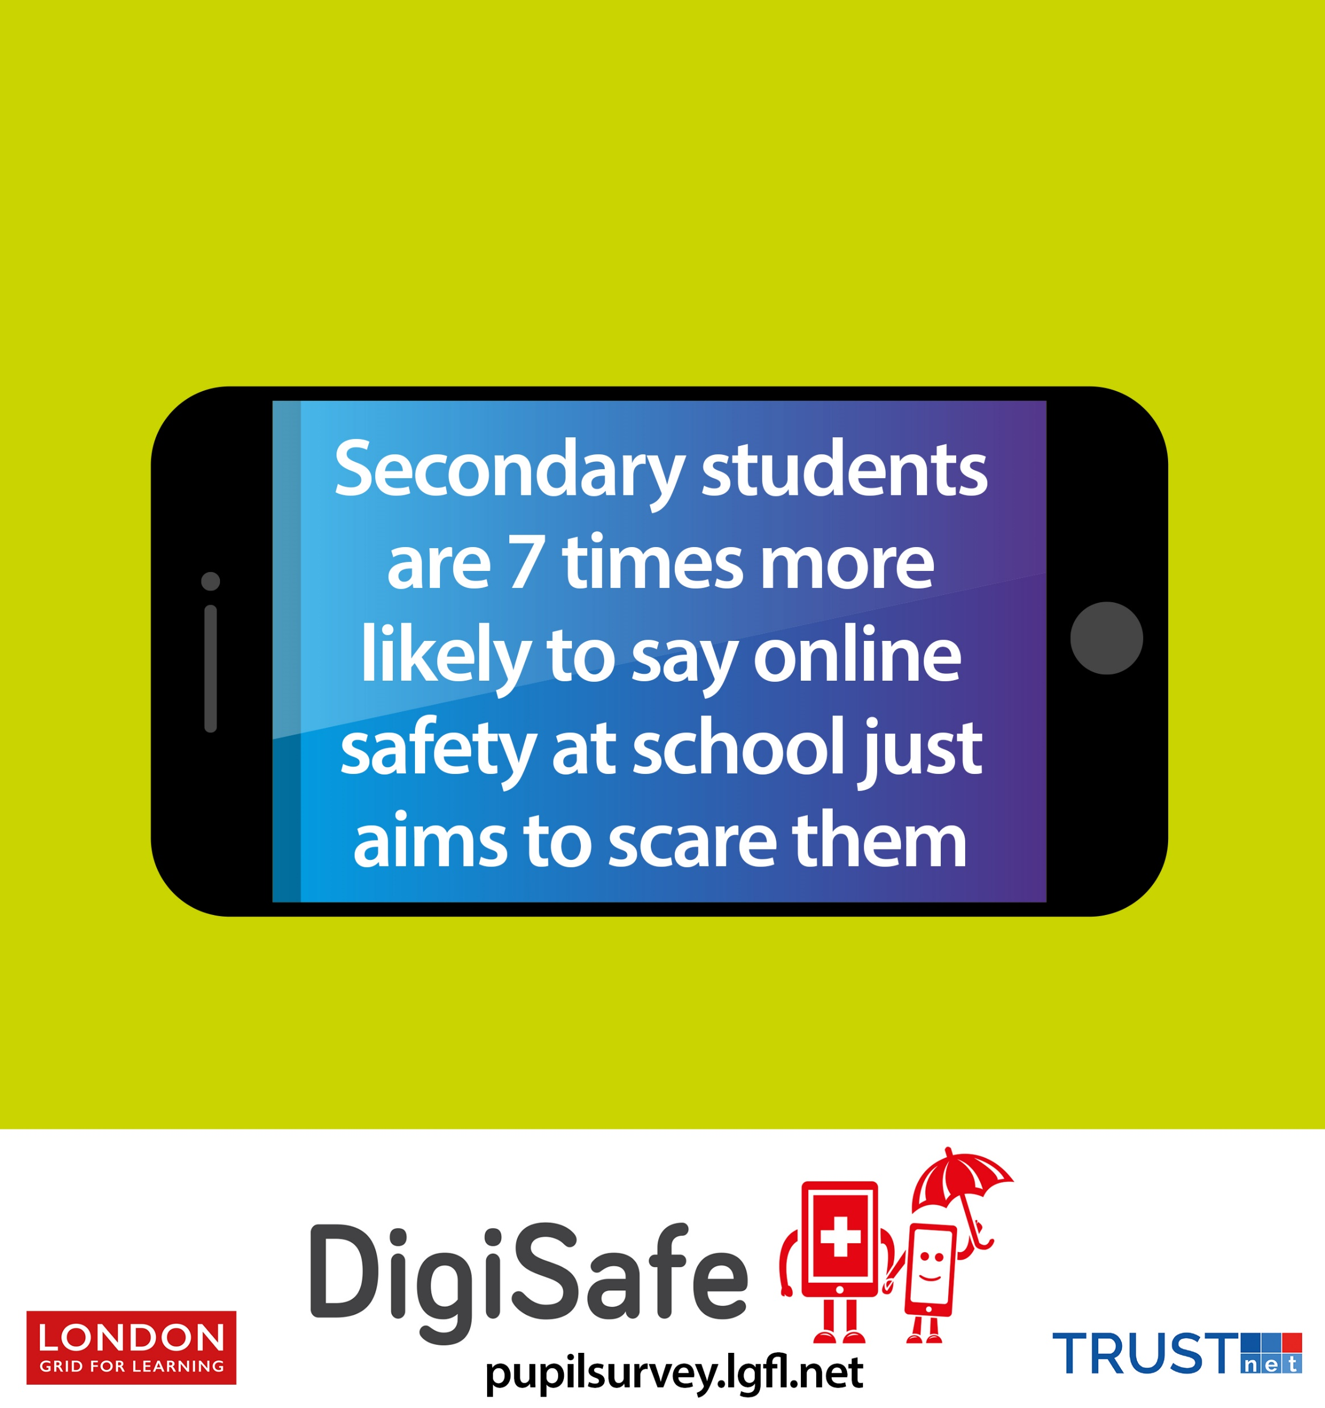
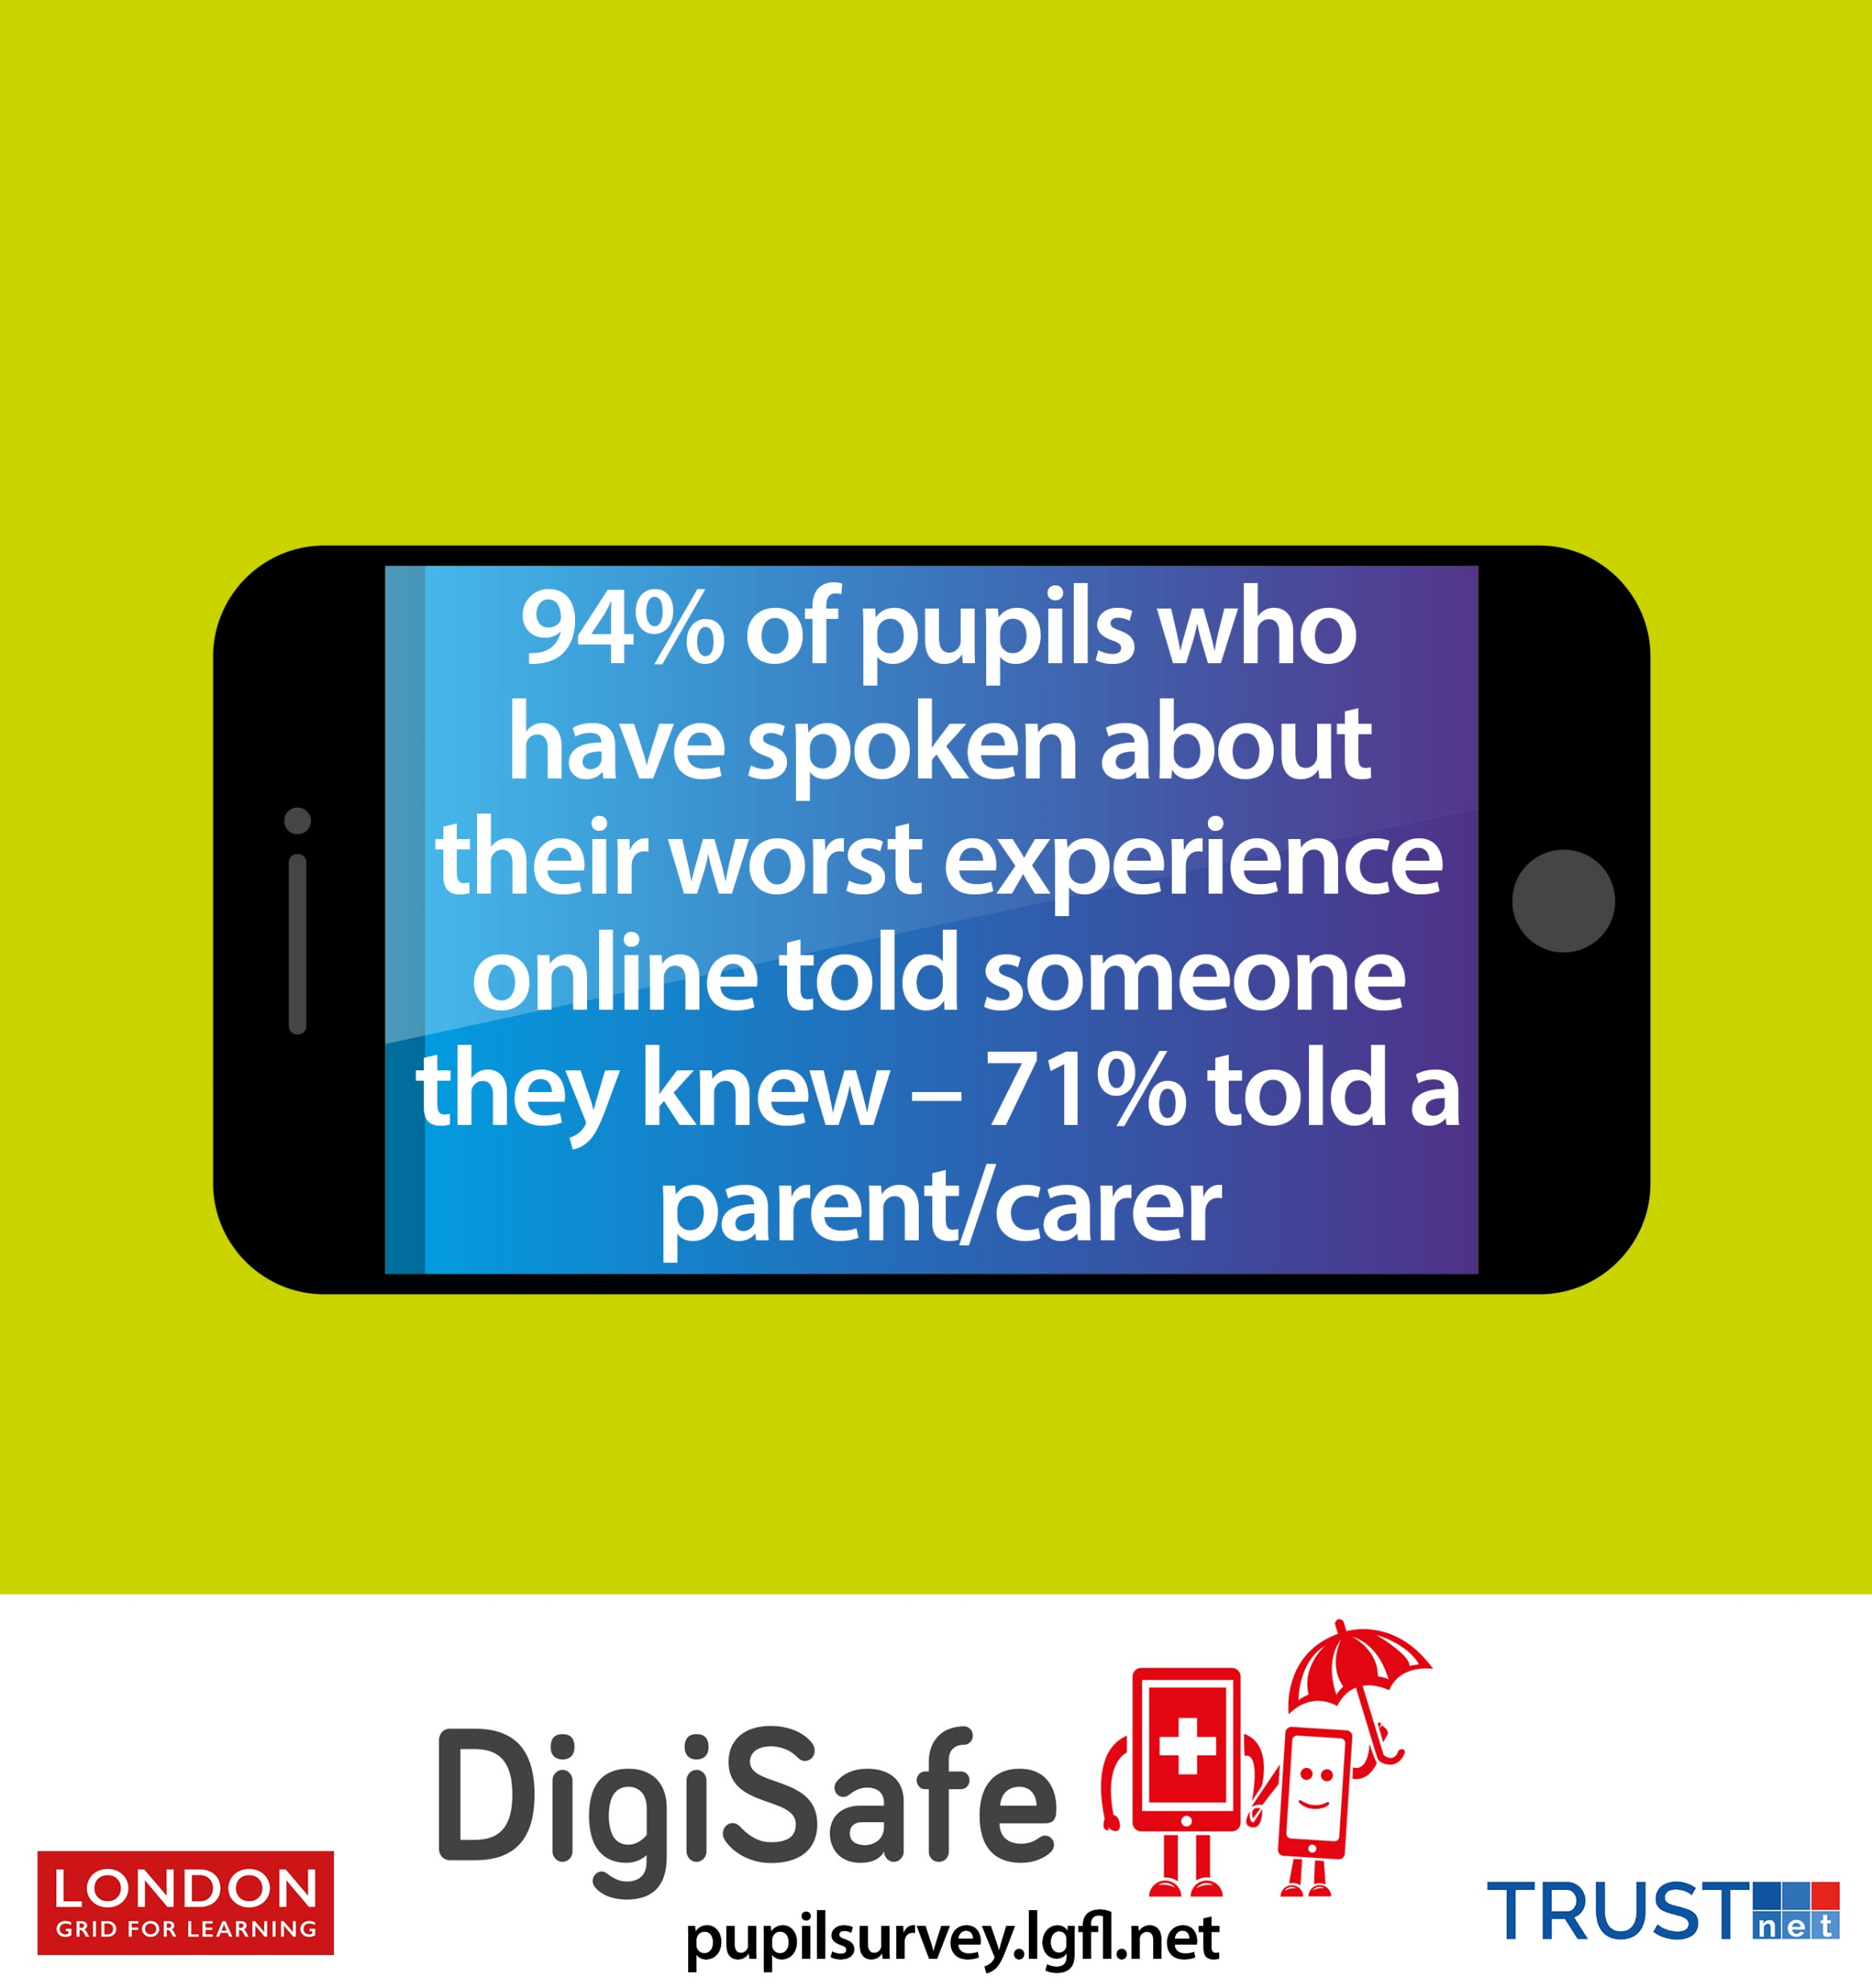
Notes:
This slide is currently hidden. If you would like to have a further discussion on who pupils are happy talking to you may wish to unhide it. There are findings around reporting and who pupils like to talk to – and if it helps – in the Hopes & Streams report – https://pupilsurvey.lgfl.net

Slide 15
Notes:
For secondary settings / this slide is currently hidden: If you have time and find it appropriate, you may wish to discuss this statistic in the context of what you have just discussed. If so, unhide the slide.

Slide 16
Notes:
If you did not already ask colleagues to watch this video before the session and have time, you could watch this together now (click on the image which will take you to https://videocentralhd.lgfl.org.uk/Premium_Watch.aspx?vid=uKmjZMfYz6ueUy
This is from the Self-Harm section of the open-access LGfL Healthy Minds resource, taken from this page: http://healthyminds.lgfl.org.uk/no-harm.html

Slide 17
Hopes & Streams report pupilsurvey.lgfl.net
Online safety / safeguarding
resources & signposting: saferesources.lgfl.net
Notes:
From our report, p 38:
“To understand self-harm in general, teachers may find it helpful to watch this advice video - https://youtu.be/j3BUV6hhYiU - for schools from the Anna Freud National Centre for Children and Families which explains why children self-harm and what responses are helpful. Also, this Healthy Schools London document has further practical guidance for managing self-harm. http://www.healthyschools.london.gov.uk/sites/default/files/Ealing%27s%20Managing%20Self%20Harm%20Guidance%202014%20FINAL.pdf

